Slide 1
Harnessing Generative AI for strategic financial data synthesis
Strategy for generating synthetic data for strategic applications in financial services
Prasanth Nandanuru ,
Distinguished Engineer ,Wellsfargo

Slide 2
Disclaimer
Views and opinions expressed in my presentation are solely my own and do not necessarily reflect the views or opinions of my employer.While my presentation may touch on some of the work that I do at my company, it is important to note that the contents of my speech are based on my own research, thoughts, and ideas. Any statements or recommendations made during my talk are not endorsed by my employer and should not be taken as official company positions or policies.

Slide 3
Agenda
Case Study : Problem Definition
Forecasting Models:Challenges
Synthetic data generation : Text and Images
Privacy
Summary

Slide 4
Problem Statement : Cash Recycling and Forecasting
Stores
Key Business Drivers:
Optimal cash management -Short vs Excess
Reduce expenses -Transportation and storage costs
Cash Forecasting -Proactive vs Reactive
Customer Experience
Transportation
Fulfillment Centers

Slide 5
Cash Positions - Explanatory vs Observation variables
Explanatory Variables
DateTimeStamp | StoreID(AU) | Line # | GeoLocation (hash) | StoreType | Start_Cash(USD) | End_Cash(USD)
2023-09-09 09:06:53 | 1234 | 11 | 2pxqmv1 | Prime | 20,010 | 80,000
2023-09-09 09:08:53 | 4567 | 42 | 9xxqmv2 | Prime | 10,000 | 4000
2023-09-09 09:08:54 | 1234 | 17 | 2pxqmv1 | Prime | 8000 | 9000
2023-09-09 09:08:53 | 8960 | 8 | 4yxqmv4 | Non Prime | 4000 | 9000
…
Observation Variables

Slide 6
Need for Synthetic Data
Privacy and Confidentiality :PII and Regulations-GDPR/CCPA/PCI
Simulations : Planning and A/B Testing
Anomalies in real data
Data corruption
Research and Collaboration : Academia and joint collaborations

Slide 7
TimeSeries Data: Forecasting Methods and Challenges
UniVariate :Time vs Target variable
MultiVariate :Time + Multiple features vs Target variable
ARMA(Stationary)/ARIMA(Non Stationary)/SARIMA (Seasonality)
ARCH/GARCH -Volatility
Prophet - takes care of missing values
ARMAX (P)/LSTM (non parametric)
DART(NBEATS)

Slide 8
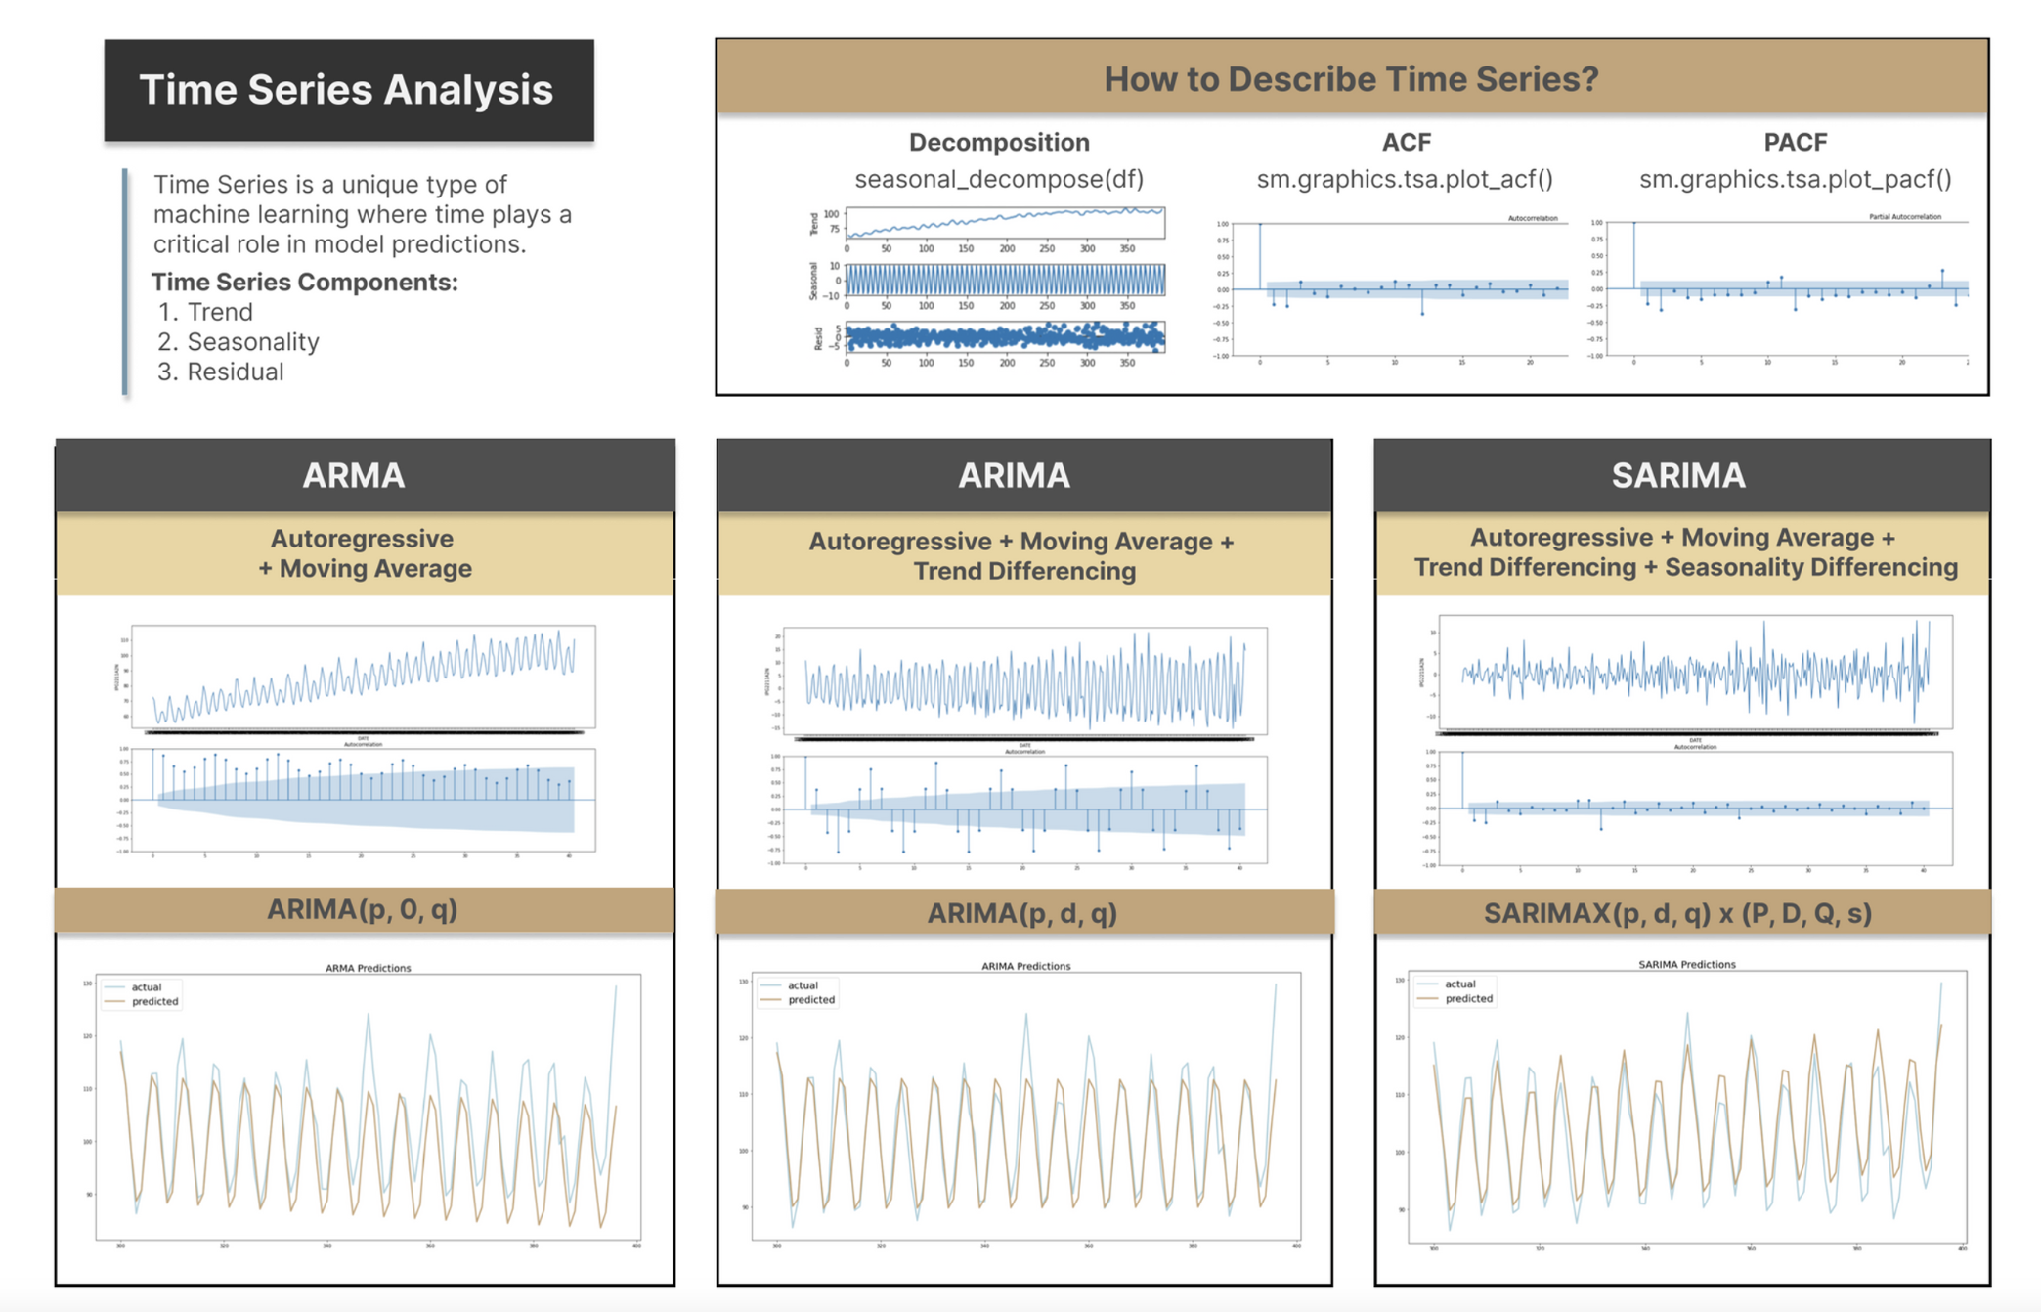
Time Series - Traditional Analysis

Slide 9
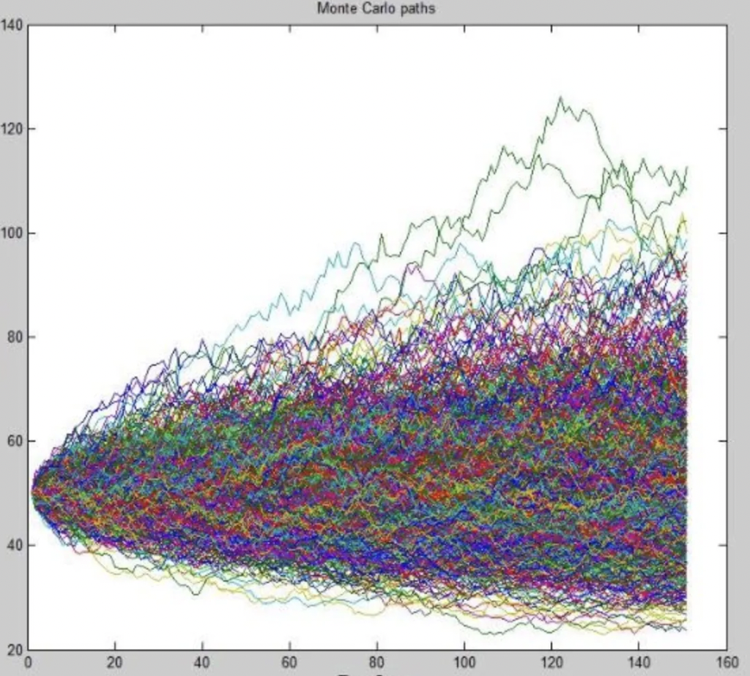
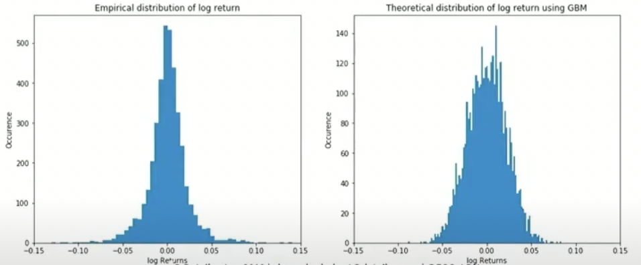
Time Series - Fat Tails Problem
Cash Forecast
TimeSteps

Slide 10
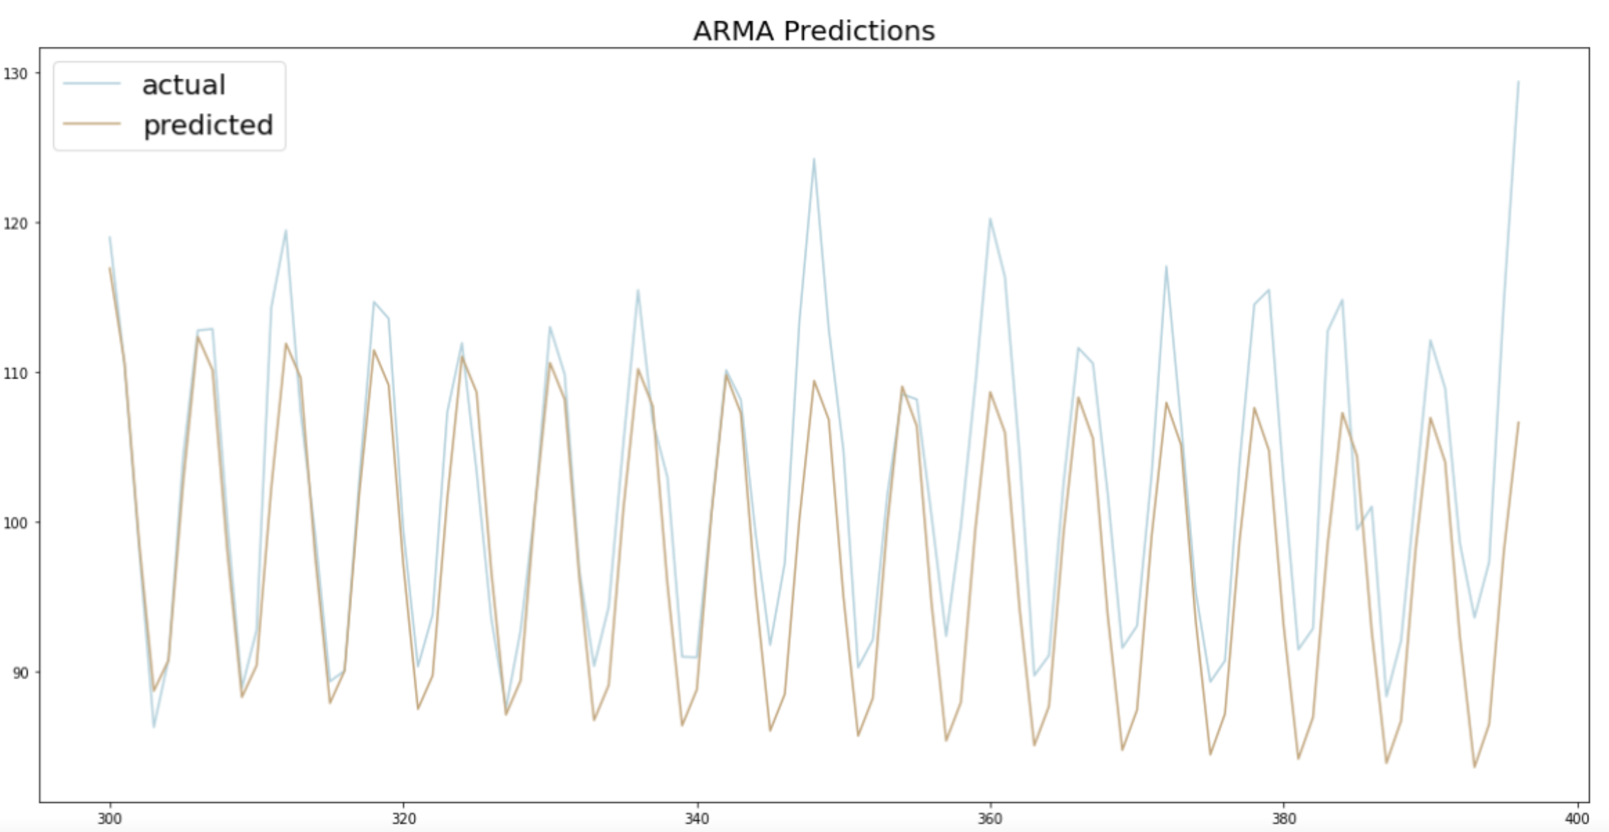
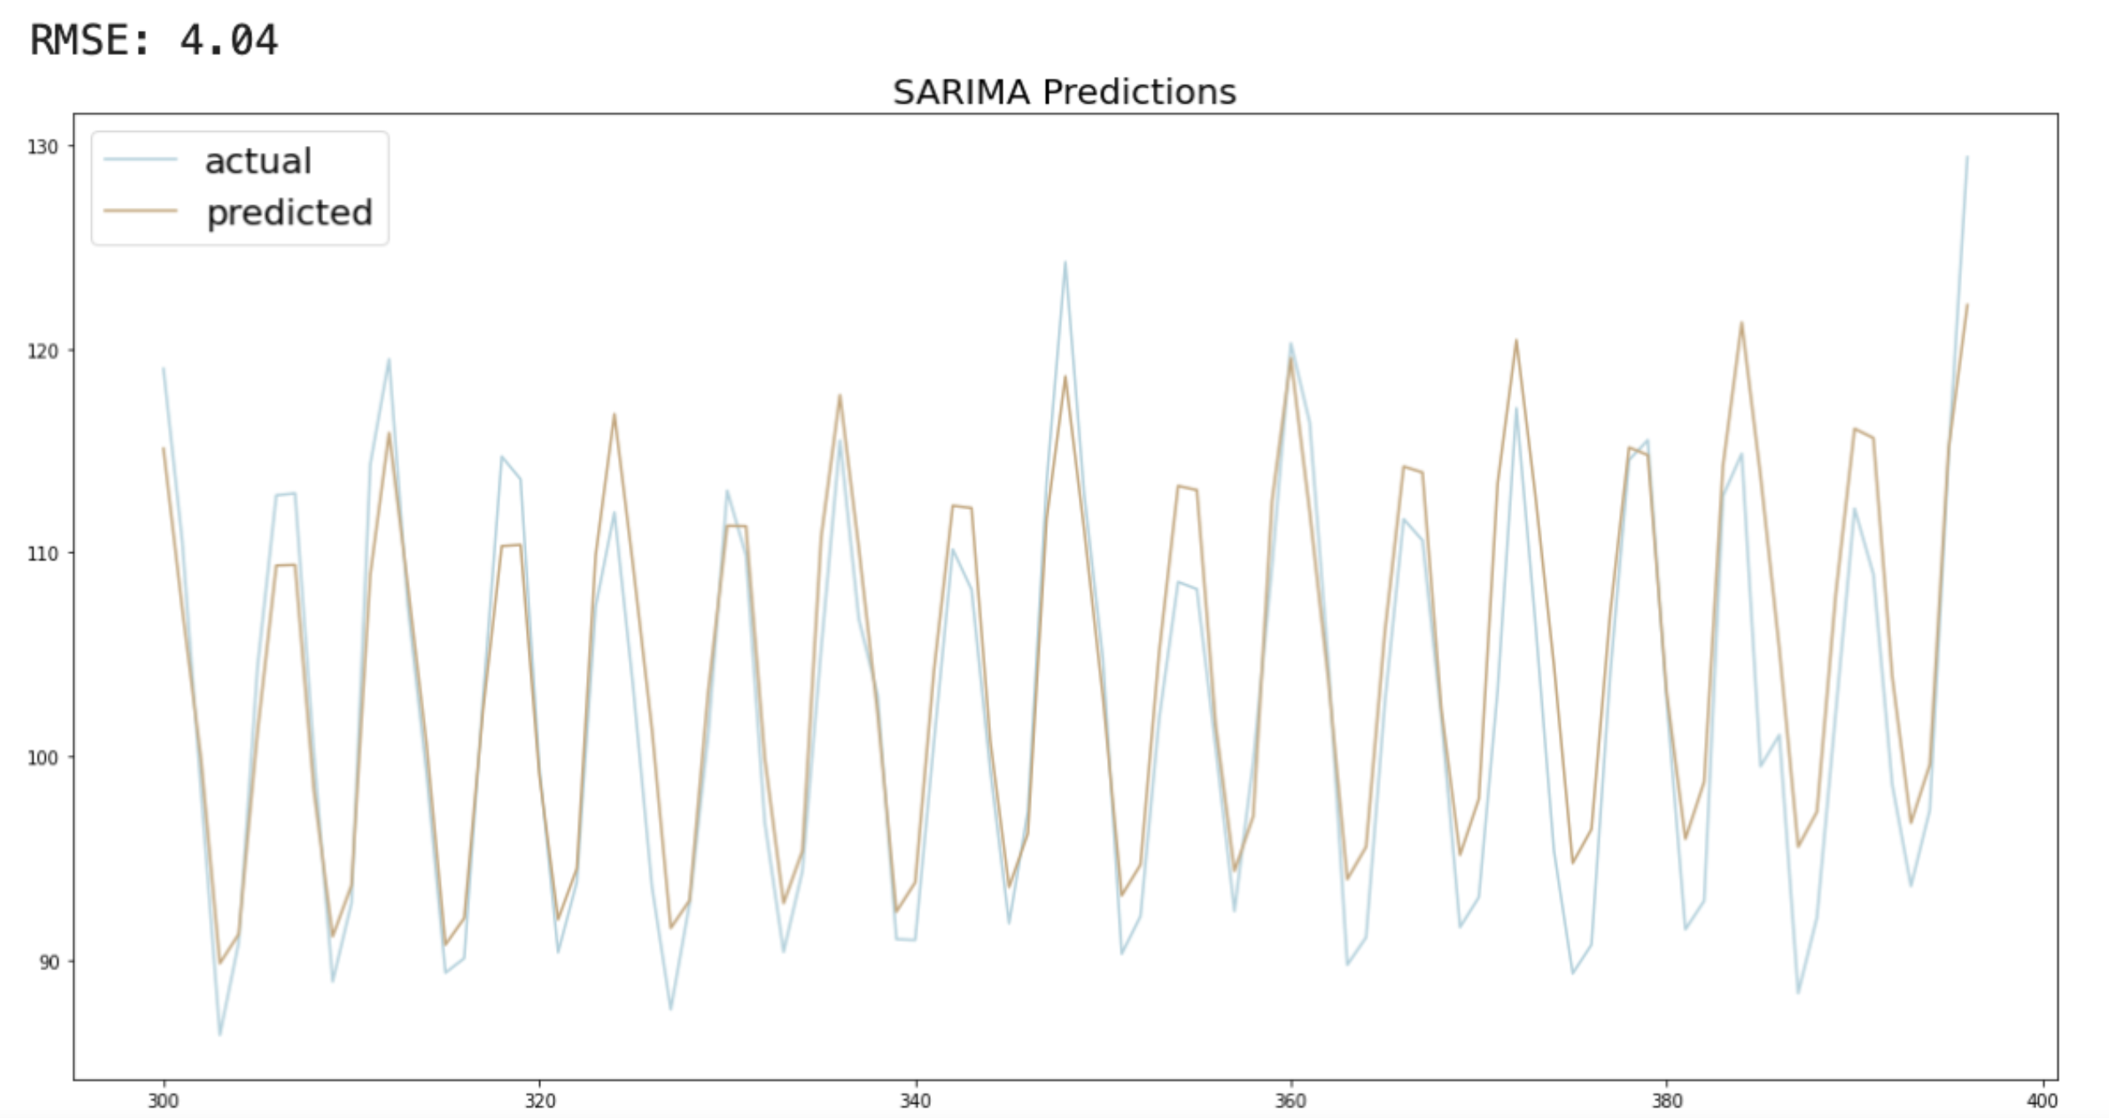
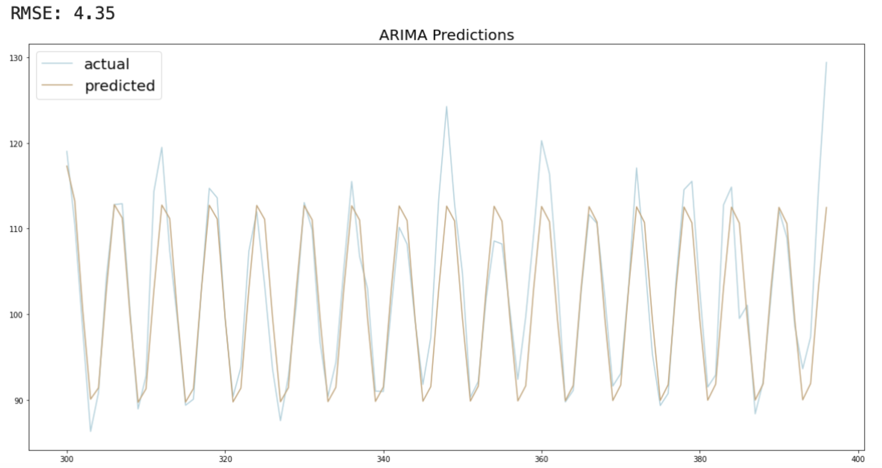
ARMA vs ARIMA vs SARIMA

Slide 11
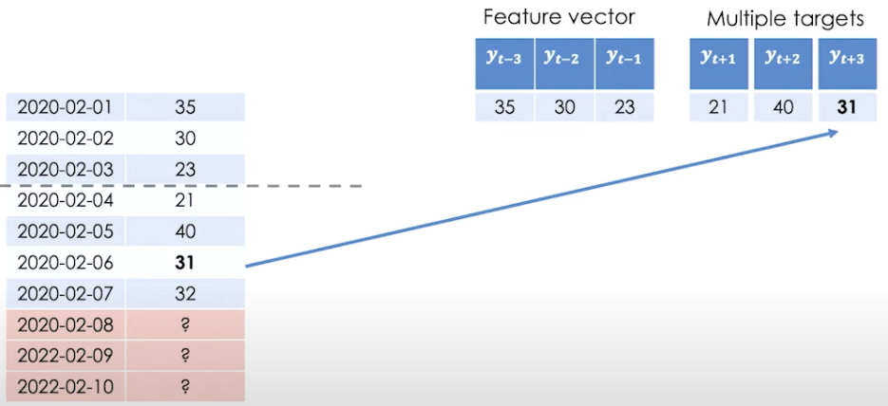
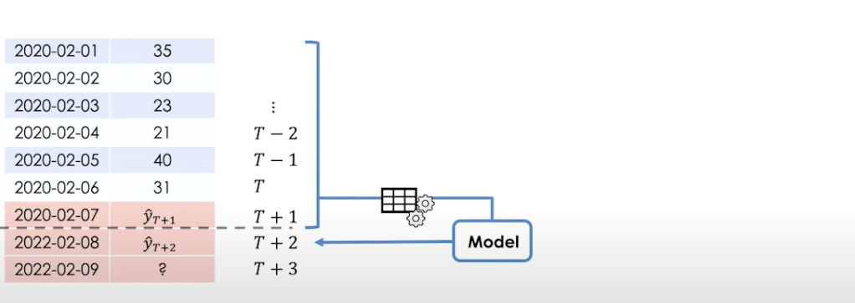
Time Series - Forecasting techniques
Date
Position
(USD in K)
Same Features with multiple models
Each model predicts different target variable
High maintenance and inefficient
Different features
Same Model predicts target variable recursively
Efficient and low maintenance

Slide 12
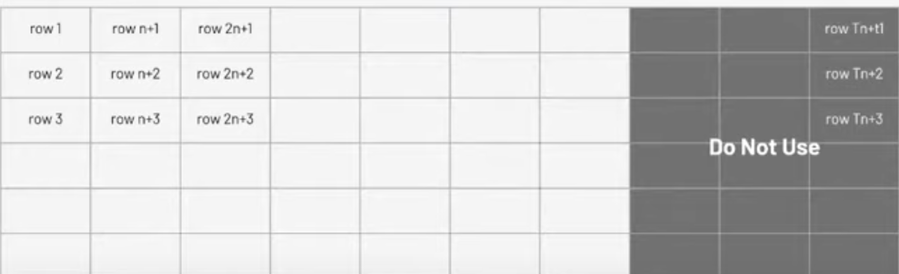

Time Series - Cross Validation
T0
T1
T2
Tt
STORE 1
STORE 2
STORE 3
Cross Validation Data
STORE n

Slide 13
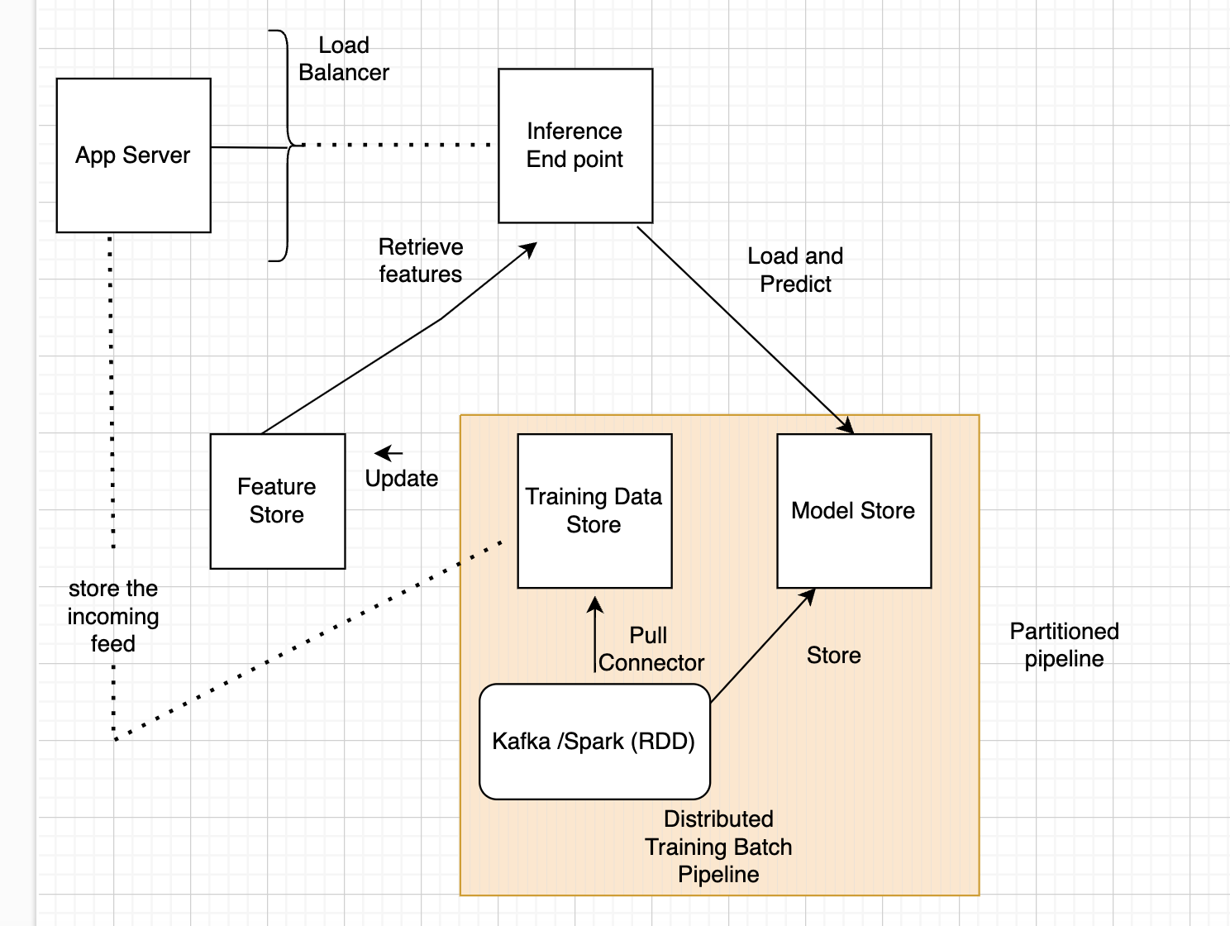
Distributed Training and Serving

Slide 14
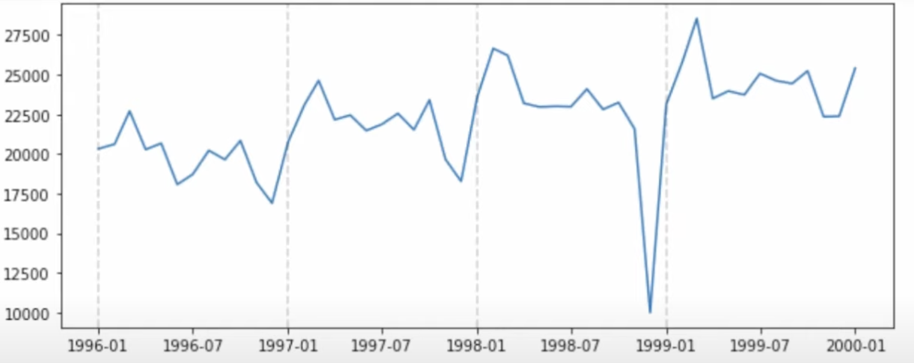
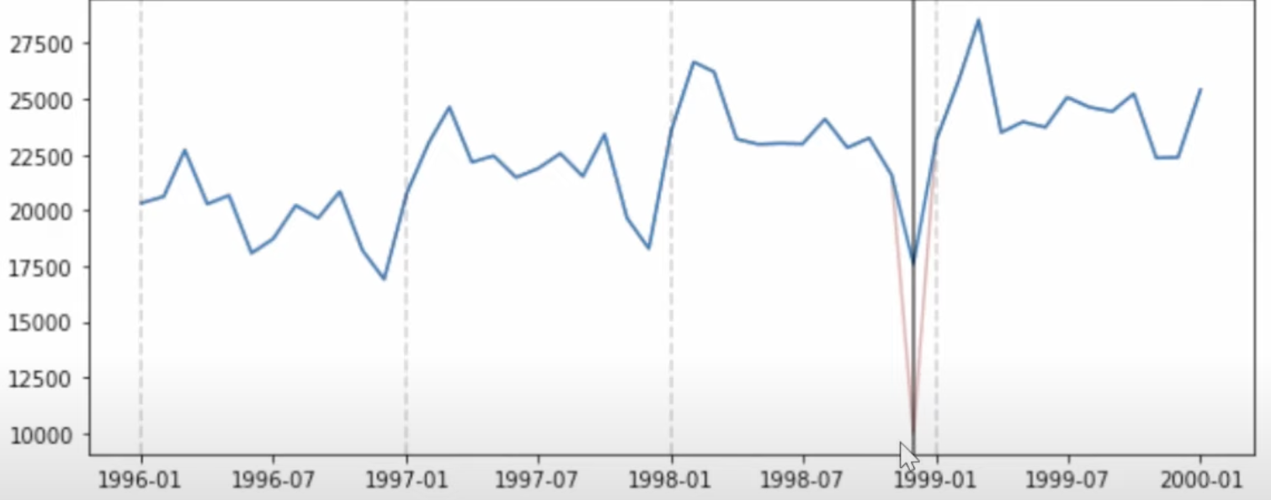
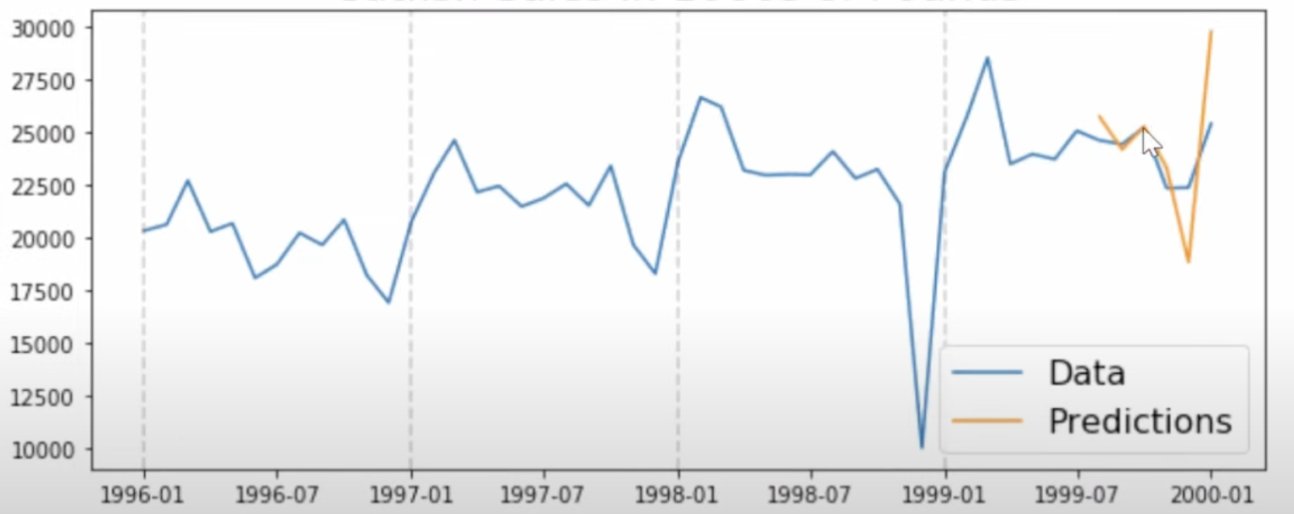
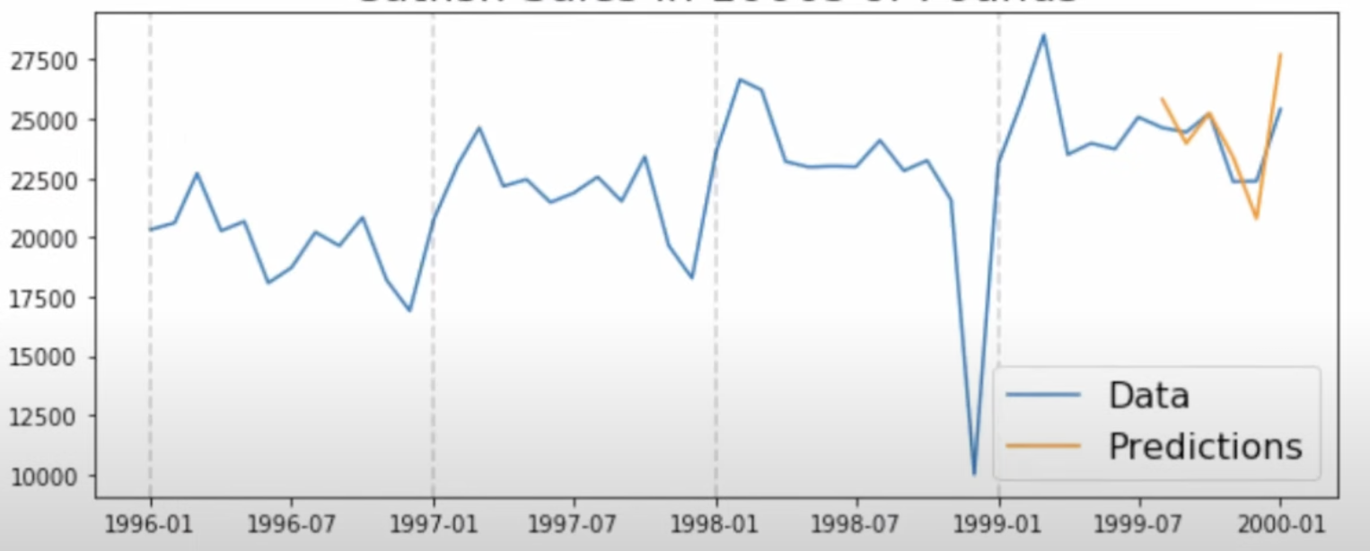
Anomaly Detection -Traditional approach
Anomaly in TimeSeries
Correct the Series using : Standard Deviation using Seasonal Method
C
a
s
h
P
o
s
i
t
i
o
n
s
C
a
s
h
P
o
s
i
t
i
o
n
s
Prediction on Anomaly Timeseries
Prediction on Corrected TimeSeries
Date Window
Date Window

Slide 15
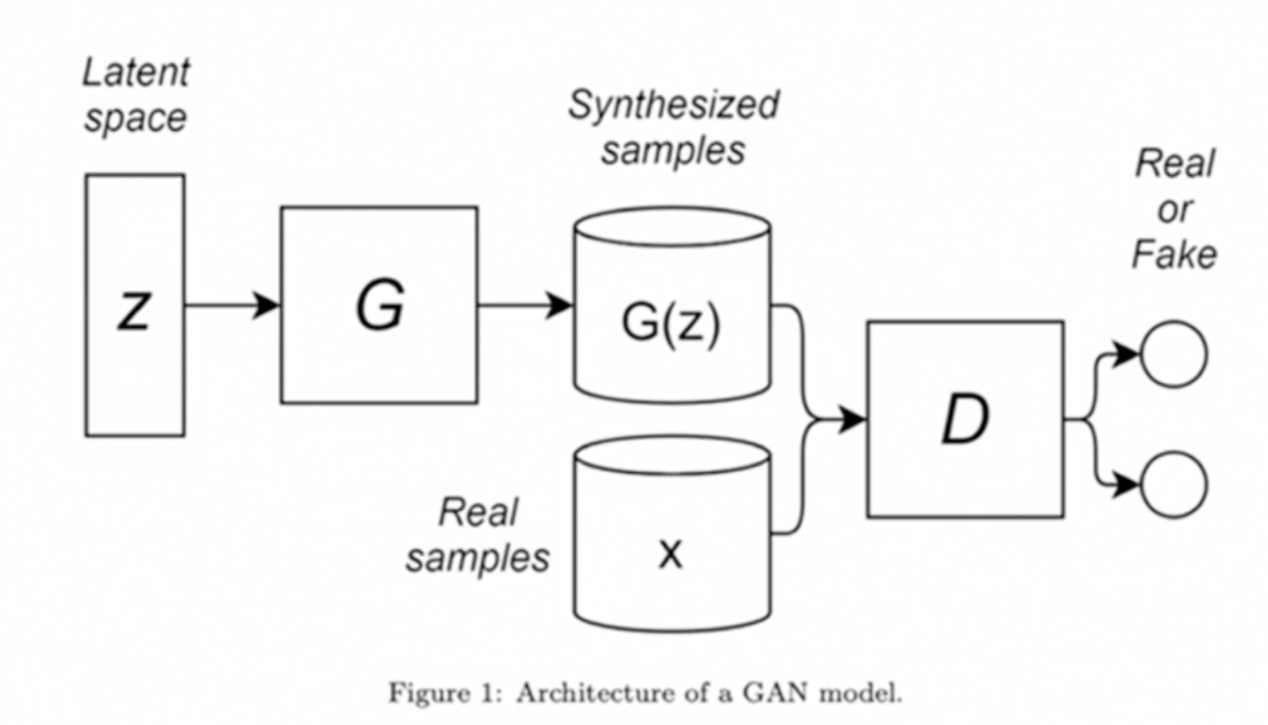
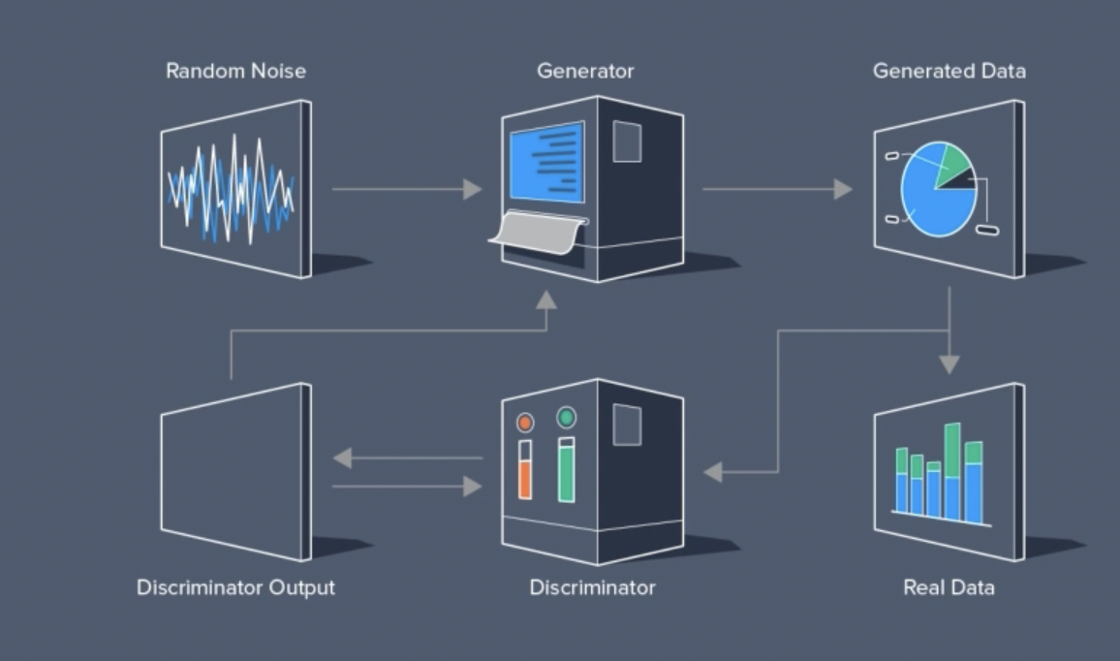
GAN -Generative Adversarial Network
Two networks -Generator and Discriminator
Generator (G) model tricks the Discriminator (D) model
to think generated model is real
If Discriminator(D) chooses a fake image as real ,
the Discriminator will adjust its model weights
If Generator(G) creates a fake image as real ,
the Generator will adjust its model weights

Slide 16
WGAN -Wasserstein GAN
Challenges with classic GAN:
Mode Collapse (stuck in peak of distribution)
Loss value vs Quality of image
Flat Gradient - Distance between distributions is very large or very small
ARMA -Stationary
WGAN :
Critic : No restrictions on value of critic (0 to 1)
No more flat gradients

Slide 17
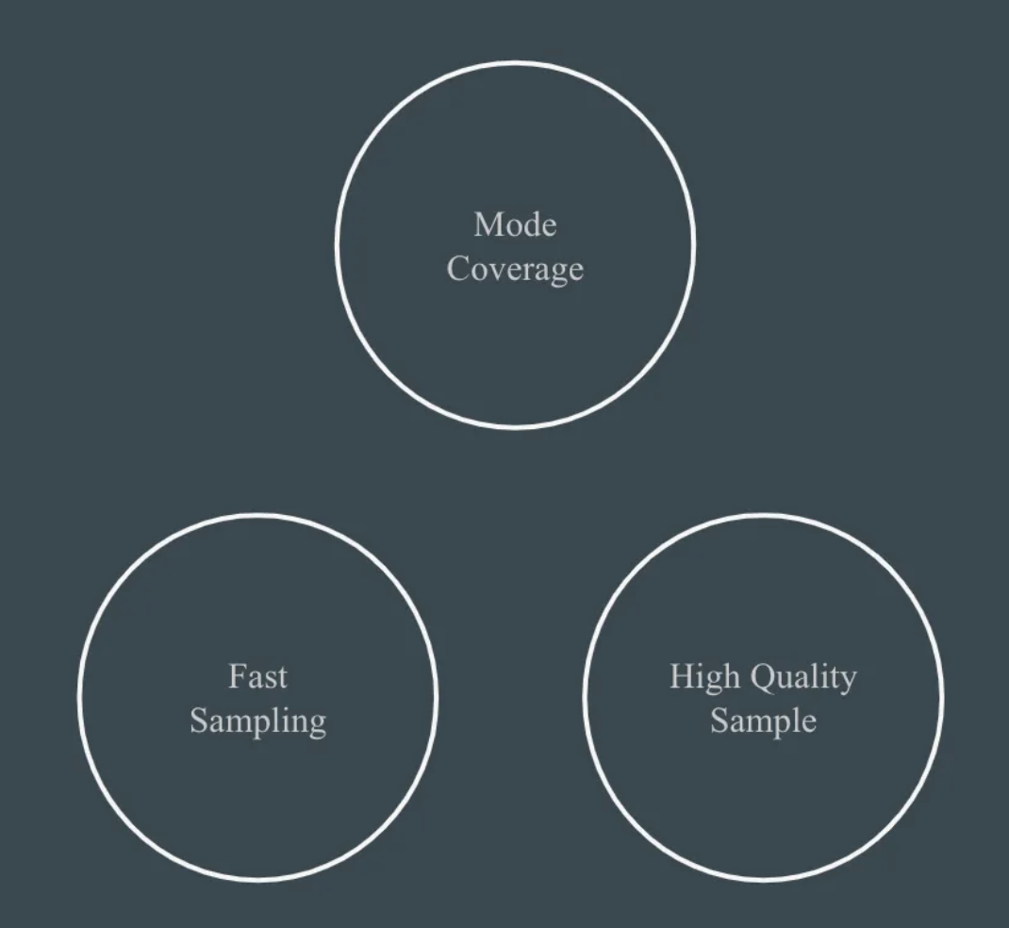
Generative Model Trilemma

Slide 18
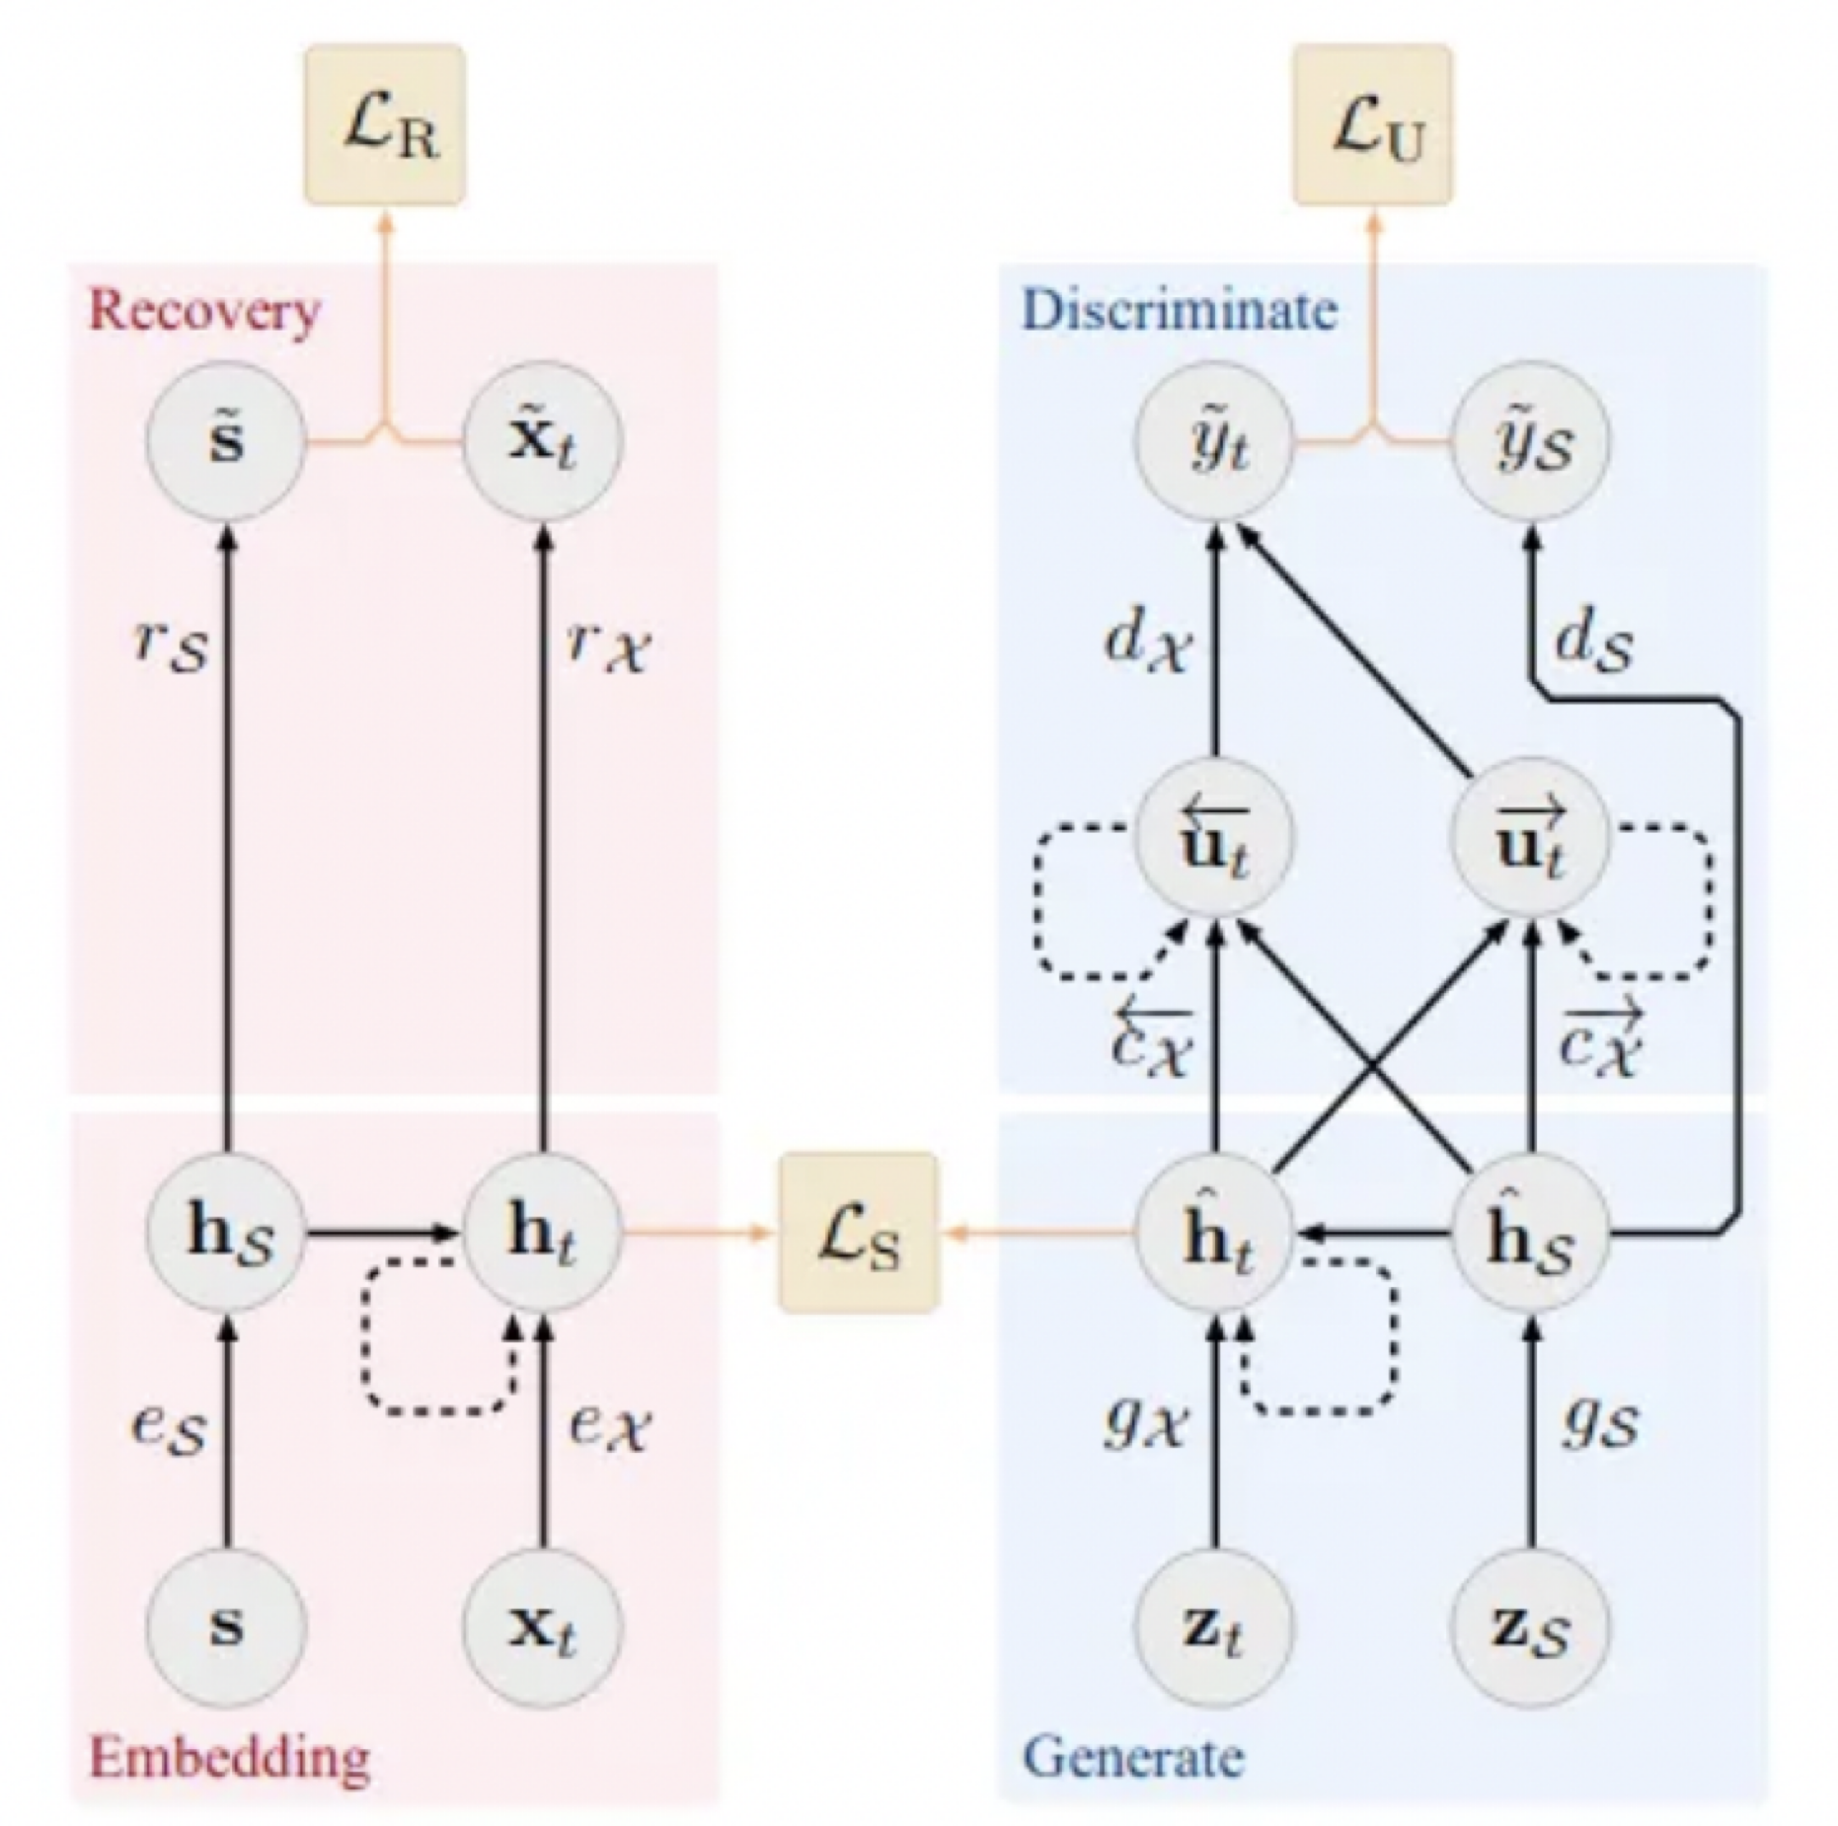
TimeGAN
Apart from Generator ,Discriminative models , there are Embedding and
Recovery models
3 loss functions - Reconstruction , Supervised and Unsupervised
Training: AutoEncoder for optimal reconstruction
Training Supervisor to capture temporal behavior
Training 4 models while minimizing the 3 loss functions
Less sensitive to hyper parameters changes and more stable
training process

Slide 19
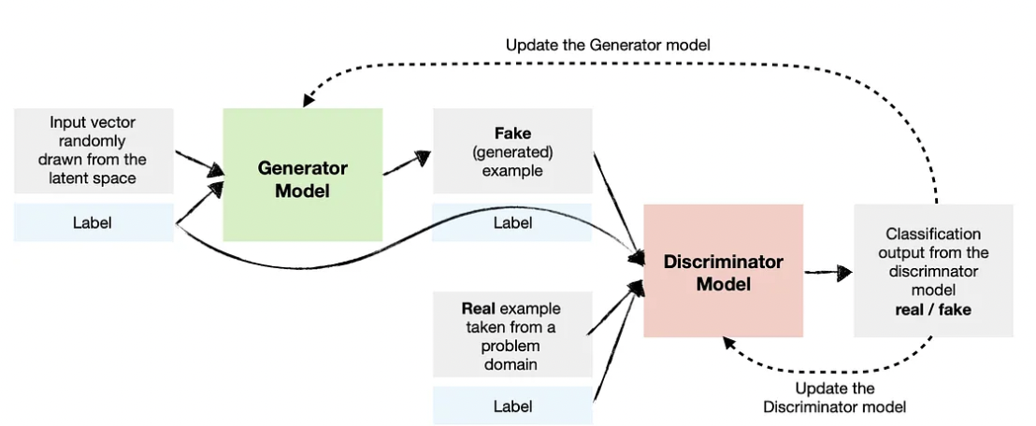
Conditional GAN - Multiple inputs

Slide 20
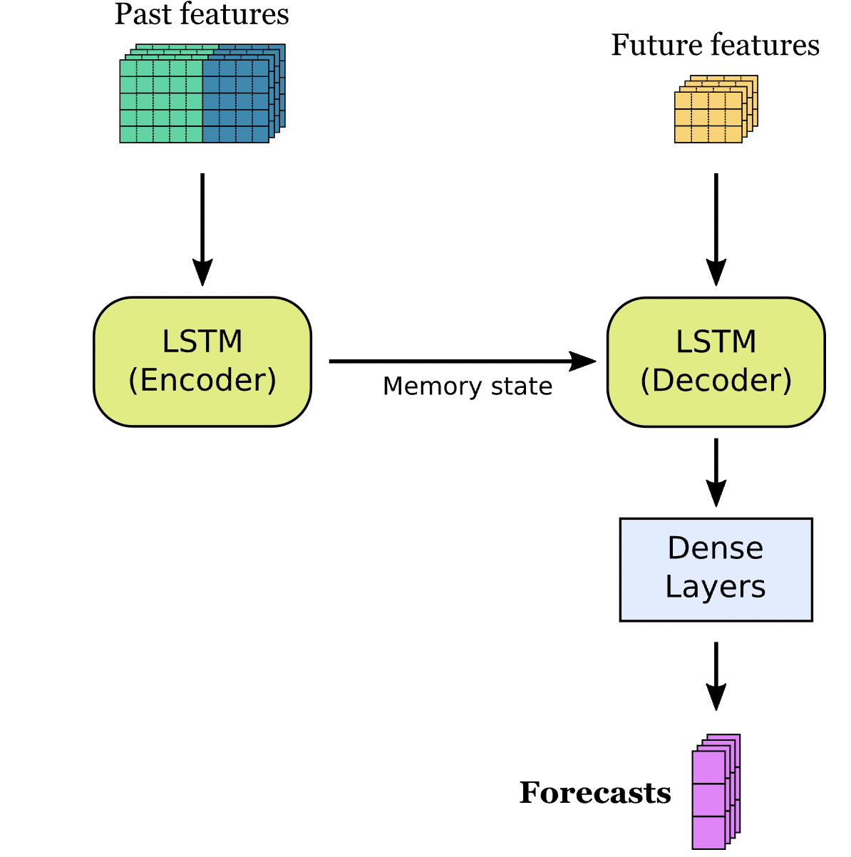
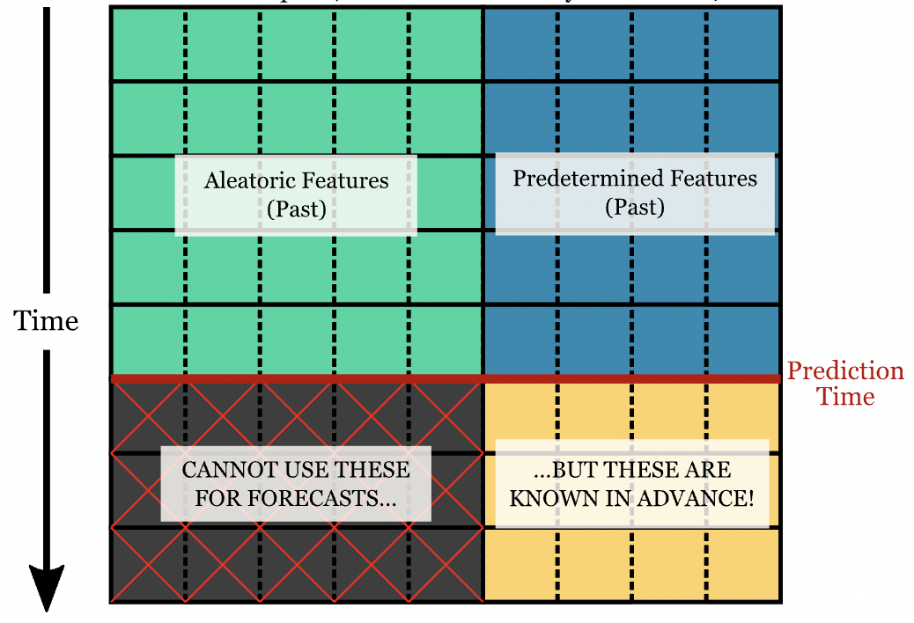
LSTM -Long Short Term Memory Models
#Deposits ,#Withdrawals #outages
Month ,Season ,day of week

Slide 21
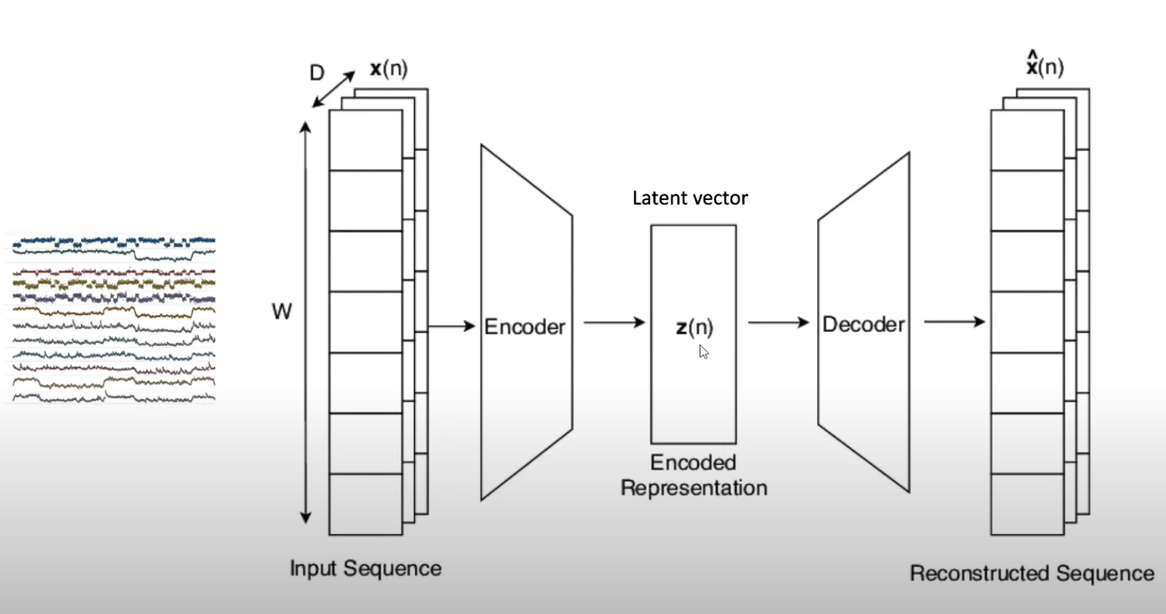
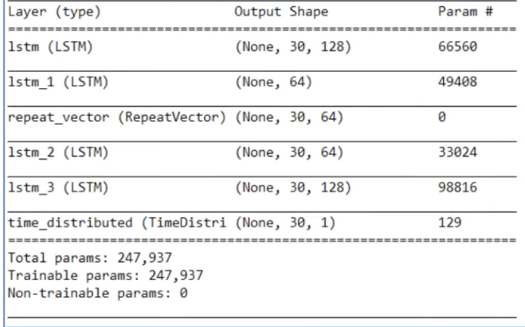
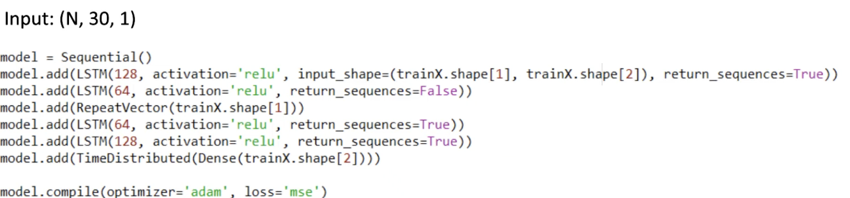
LSTM -Anomaly Detection

Slide 22
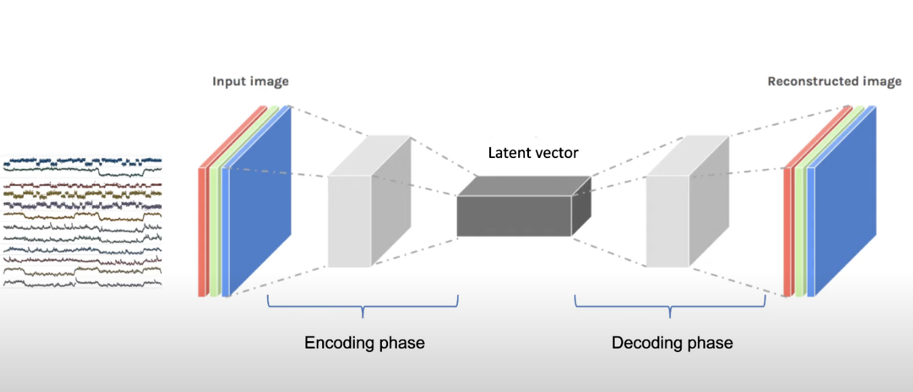
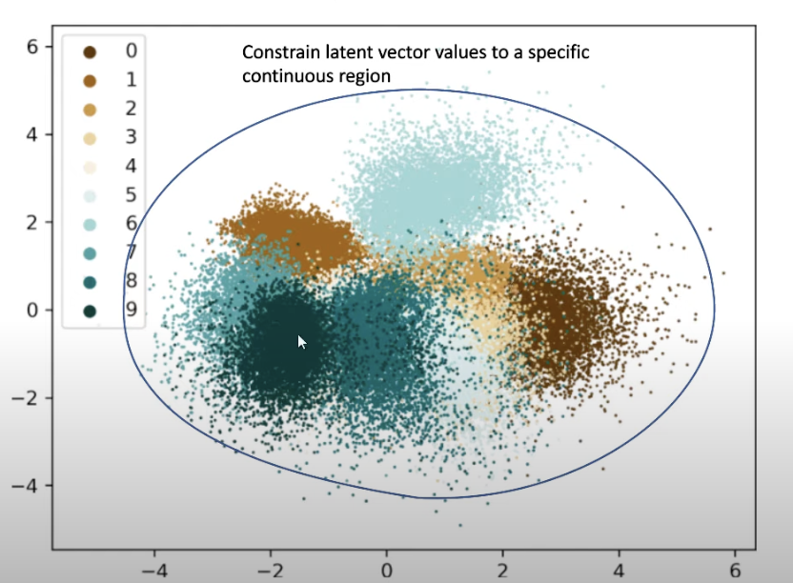
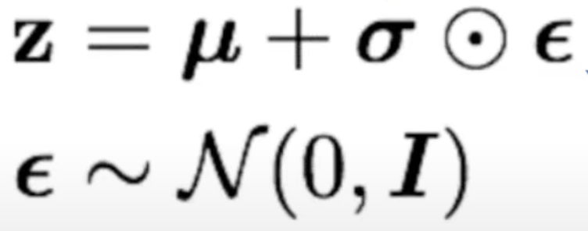
Variational AutoEncoders -Reparameterisation Trick
Learned parameters (during back propagation)
Standard normal distribution
﻿﻿Fixed space where we randomly sample
﻿﻿Not learned during back propagation

Slide 23
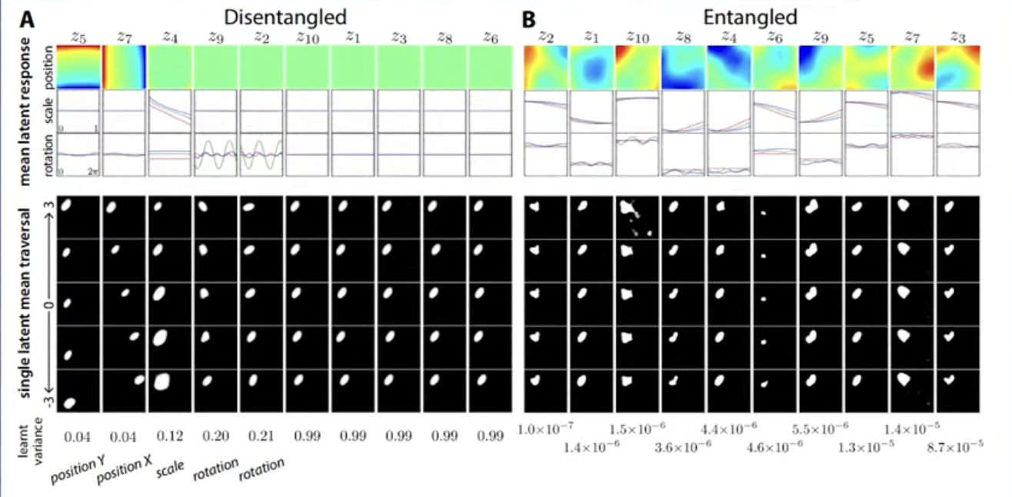
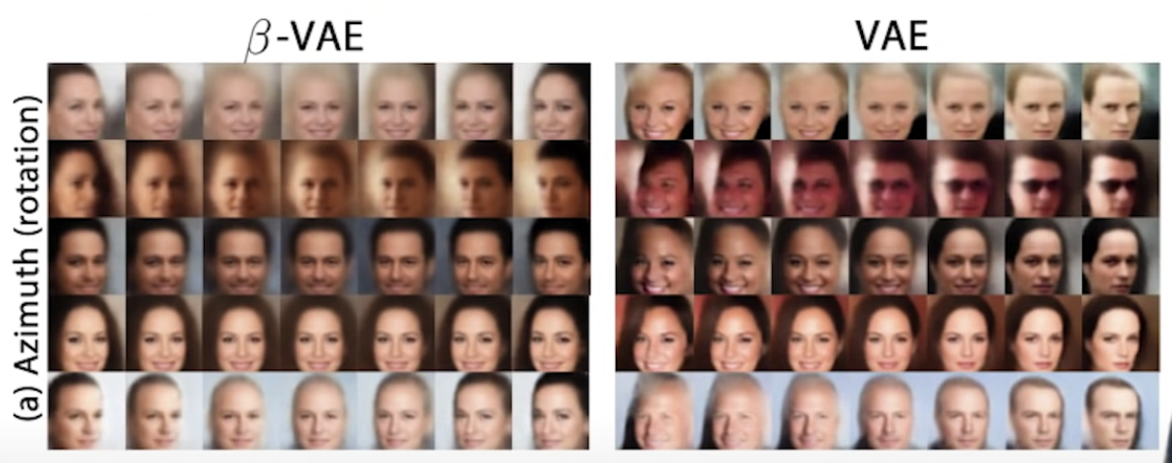
Disentangled Variational AutoEncoders

Slide 24
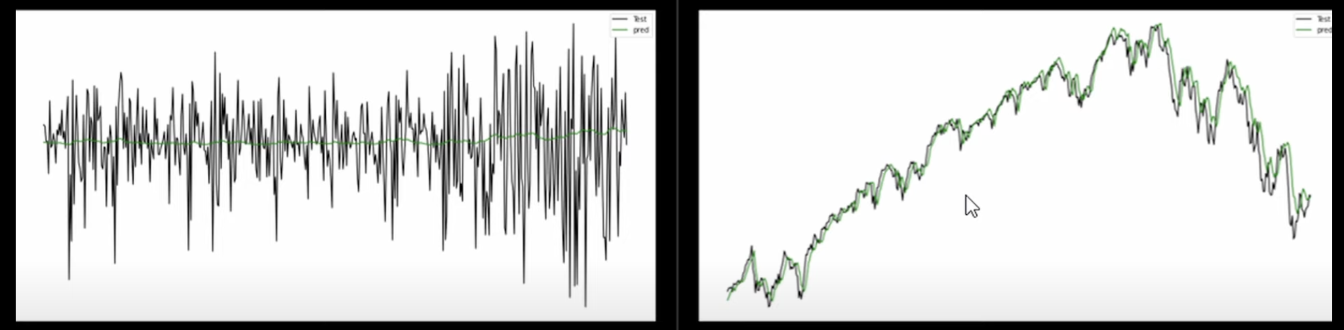
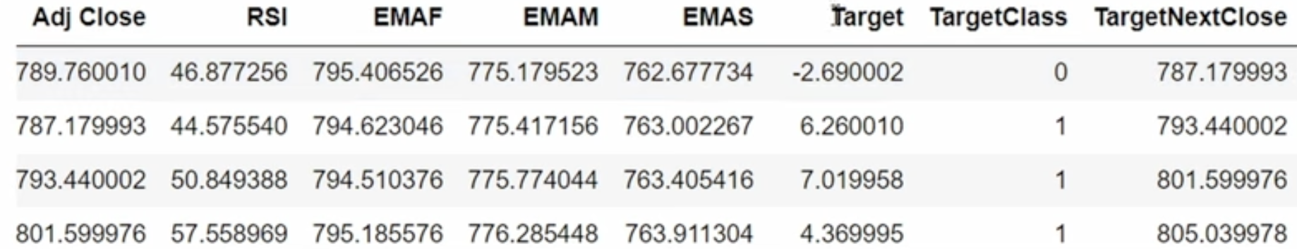
LSTM Tricks : Price Movements vs. Close price in Trading securities

Slide 25
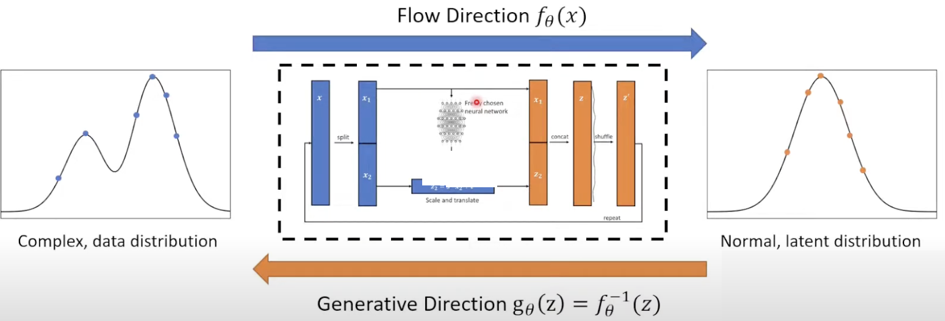
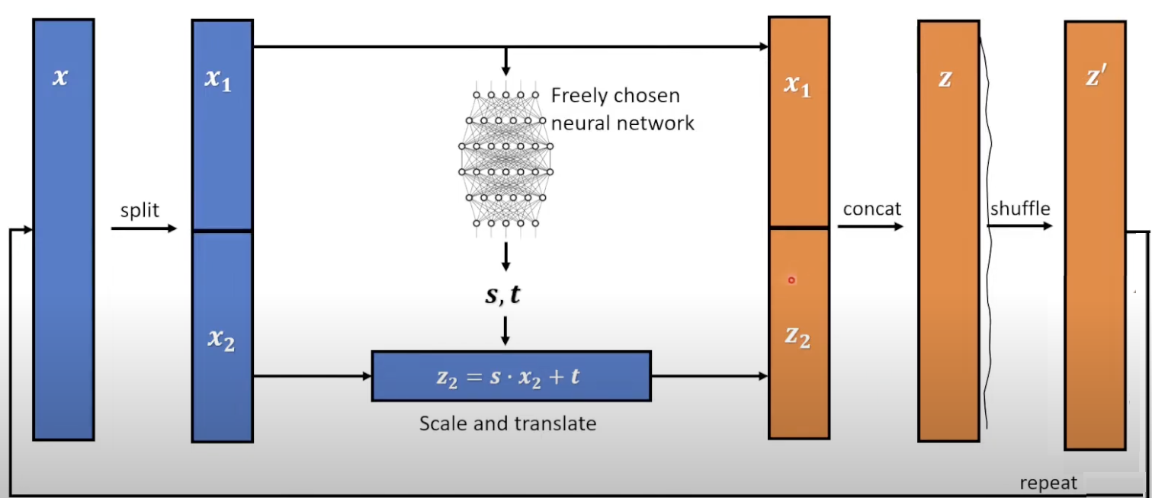
Flow based models

Slide 26
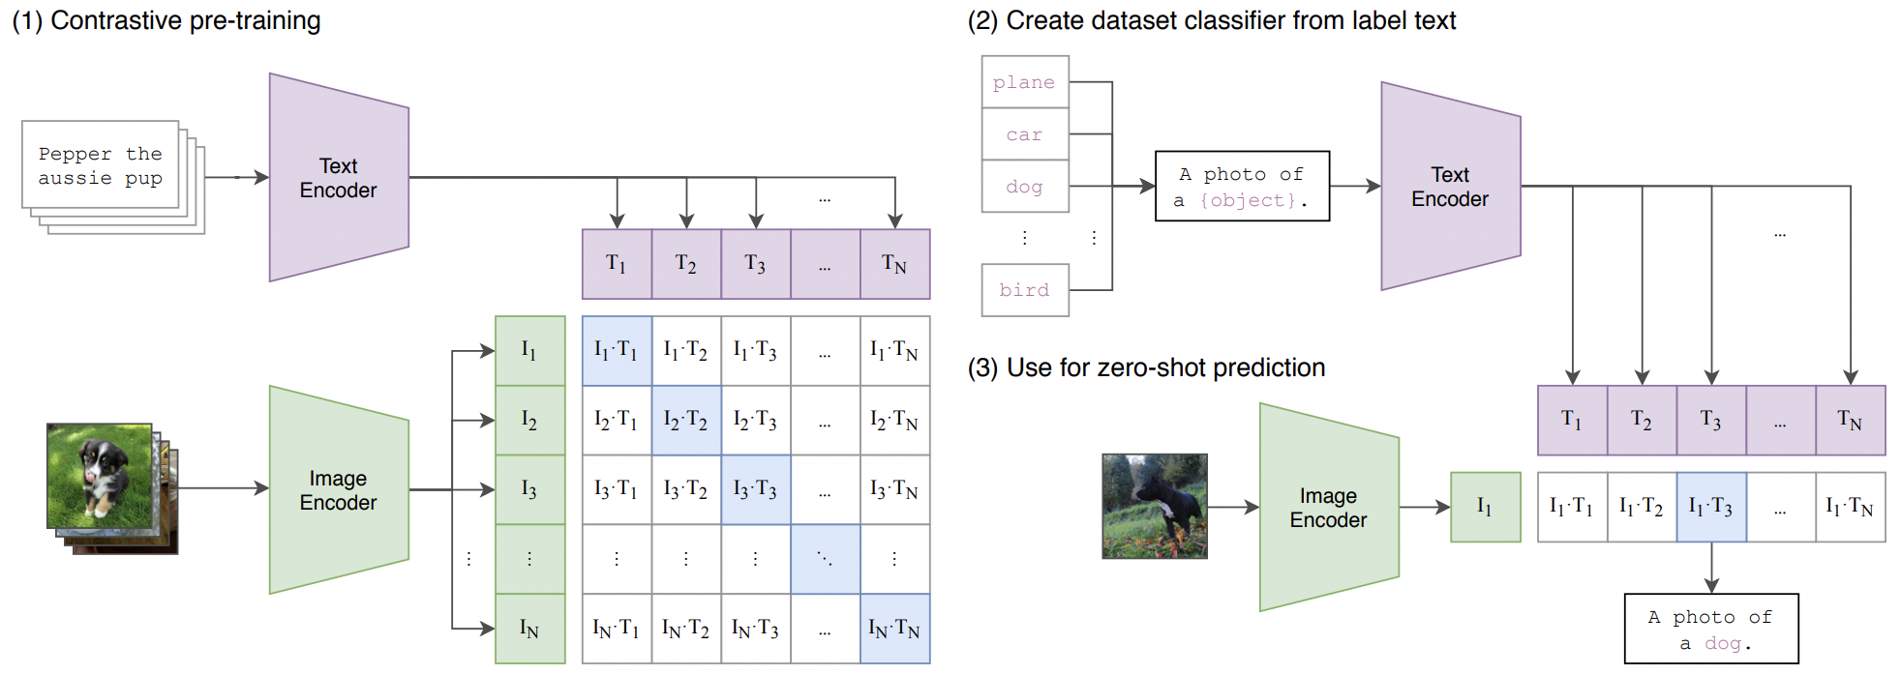
CLIP MultiModal architecture -Generate synthetic data based on text and image
CLIP: Contrastive Language-Image Pre-Training

Slide 27
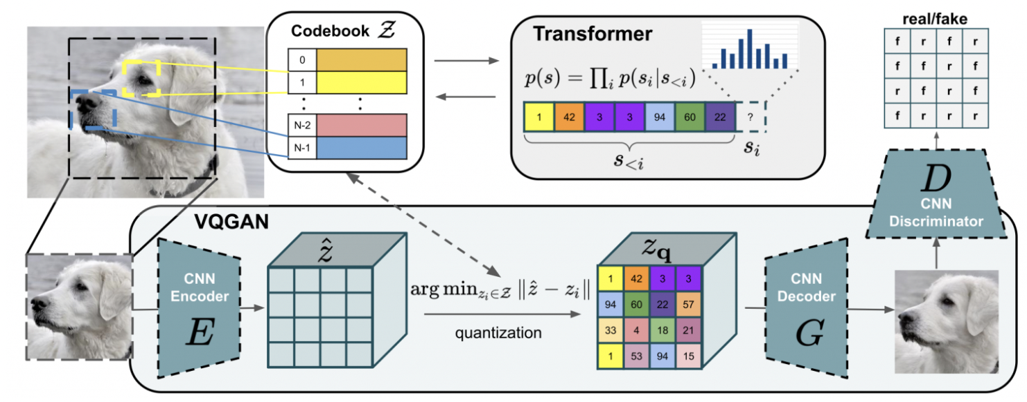
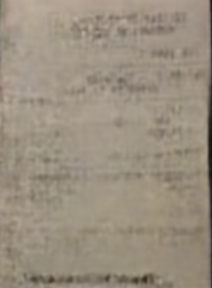
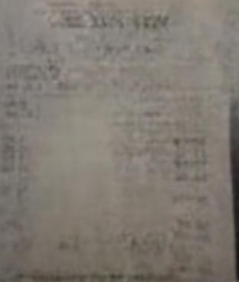
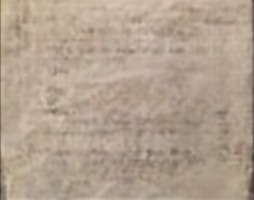
VQGAN - Generate Synthetic Paper Receipts
Fig.a
CLIP
LOSS FUNC
Fig.b
INCLUDE PROMPTS
Encode Text
COSINE Similarity
Encode Image
EXTRA Calculations
Include PROMPT Encoding
Exclude PROMPT Encoding
Update Parameters
EXTRA PROMPTS
Multiple Crops
Augmentation
Back Propagation
LATENT SPACE
Parameters
Decoder
VQGAN TRANSFORMER
post_quant_conv
GENERATIVE MODEL

Slide 28




VQGAN - Generate QR codes
Fig.a
Text Prompt: Ancient Village
CLIP
LOSS FUNC
INCLUDE PROMPTS
Encode Text
COSINE Similarity
Encode Image
EXTRA Calculations
Image
Include PROMPT Encoding
Exclude PROMPT Encoding
Update Parameters
EXTRA PROMPTS
Multiple Crops
Augmentation
Back Propagation
LATENT SPACE
Parameters
Decoder
VQGAN TRANSFORMER
post_quant_conv
Fig.b
GENERATIVE MODEL

Slide 29


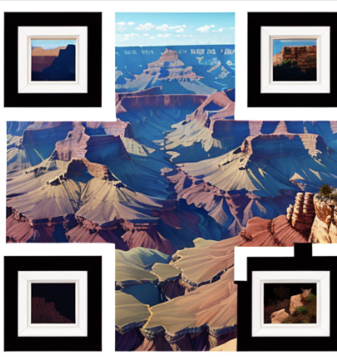





VQGAN - Generate scannable QR codes based on famous locations
Prompt:
Grand Canyon
Mount Rushmore
Golden Gate bridge

Slide 30
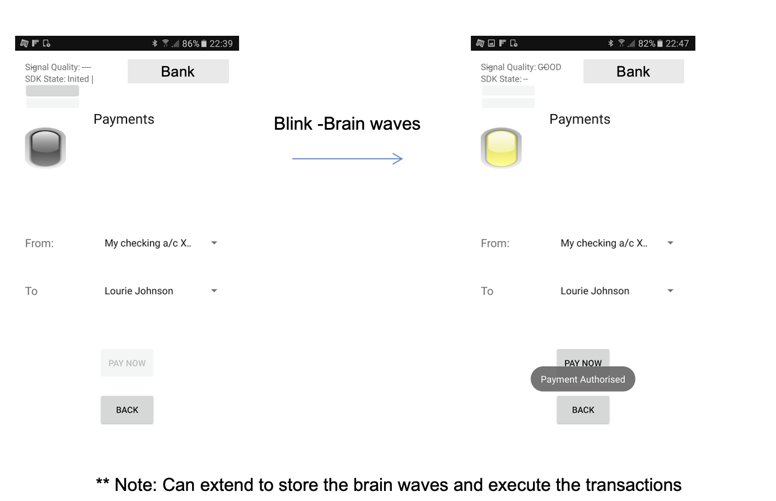
Wave2Text -Brain Waves to Text

Slide 31
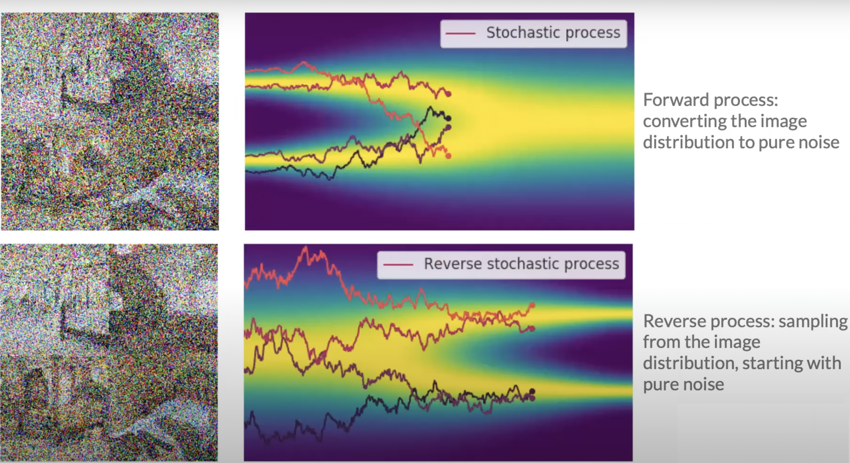
Diffusion Models :Forward and Reverse Process

Slide 32
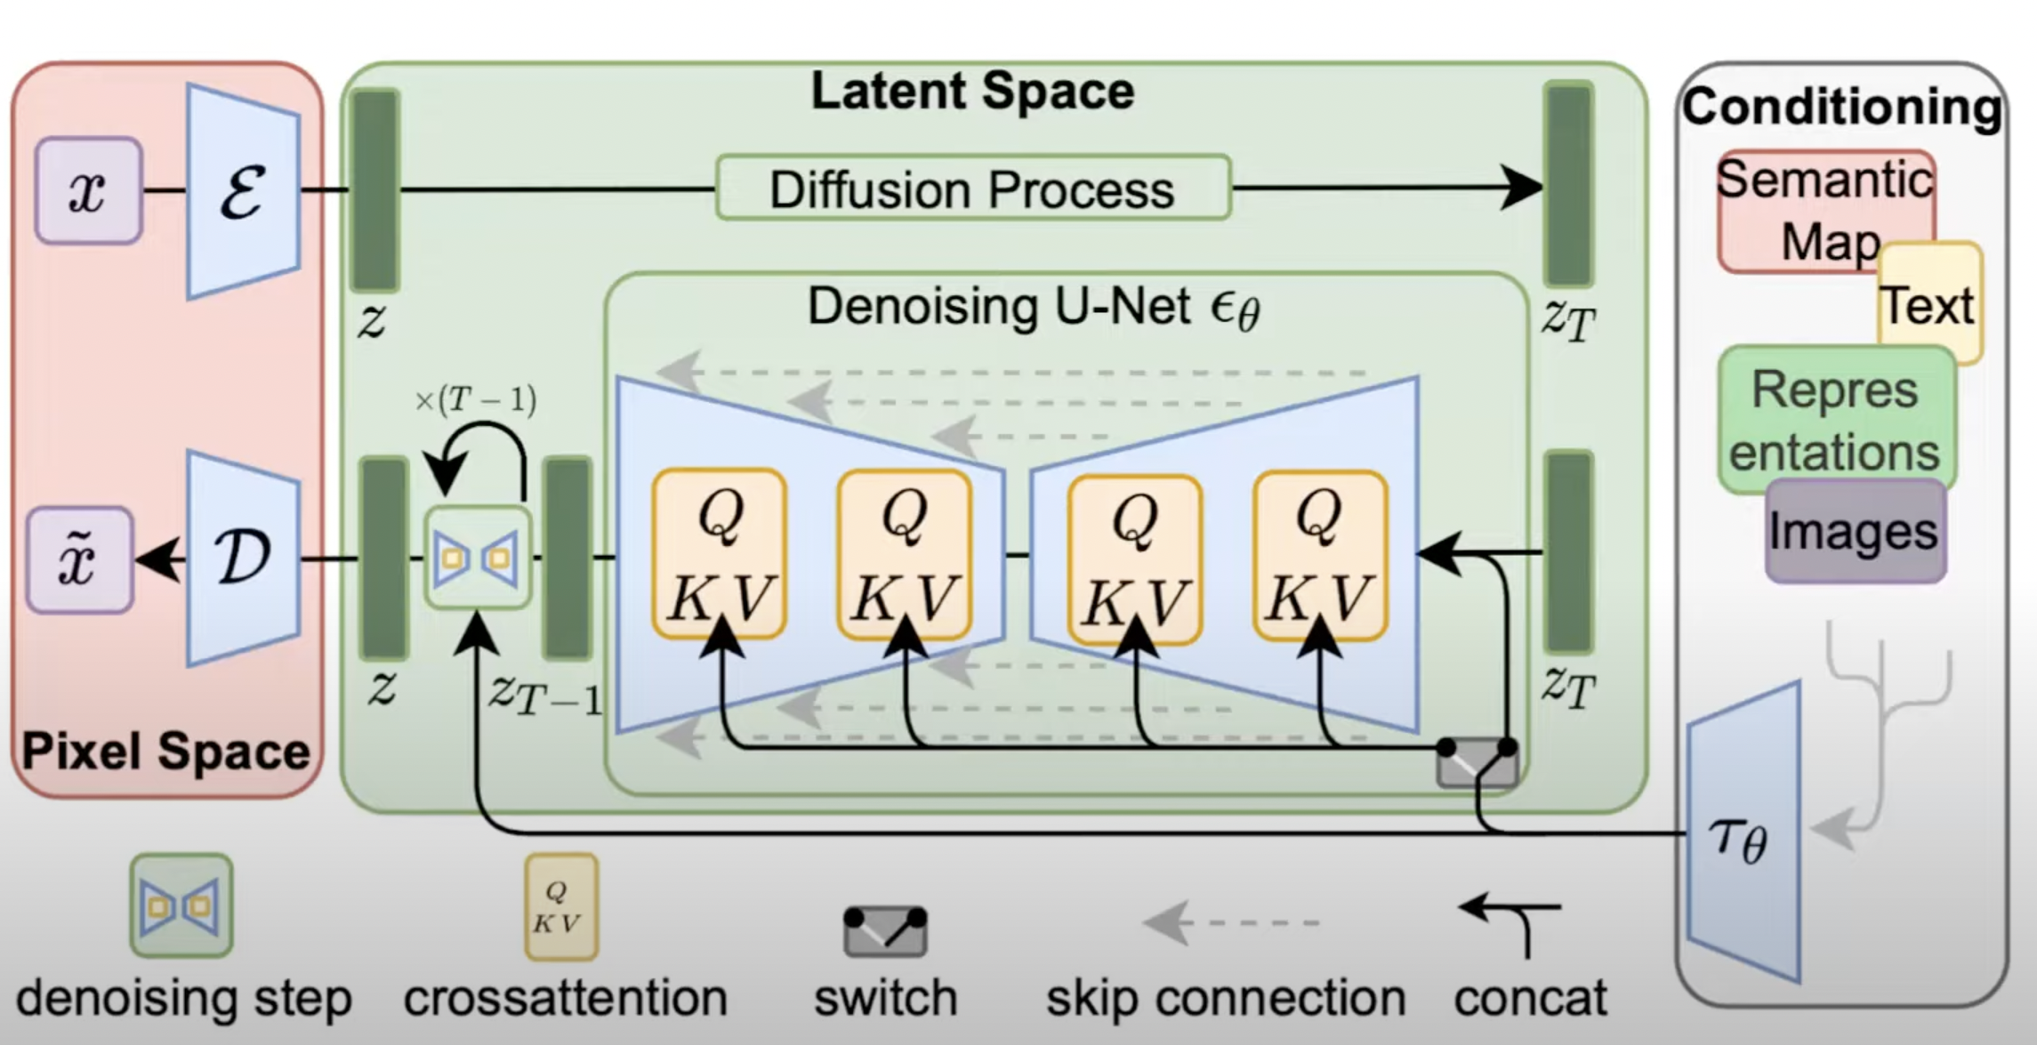
Stable Diffusion

Slide 33
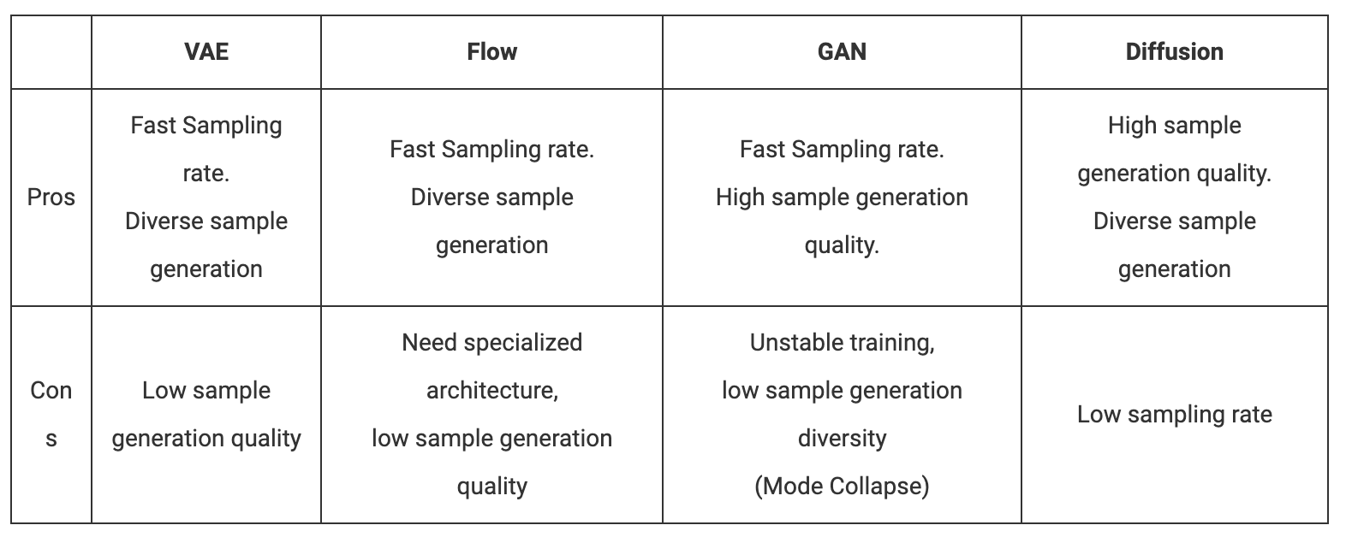
To summarise …

Slide 34
NFT Generator - Stable diffusion Model
Accounts
Smart contract
Order
Wallet
Mint
Browser
DALL-E2
AI Generator
Connect
Request
Midjourney
WebPage
Stable diffusion
Image
Image
URL path
IPFS

Slide 35
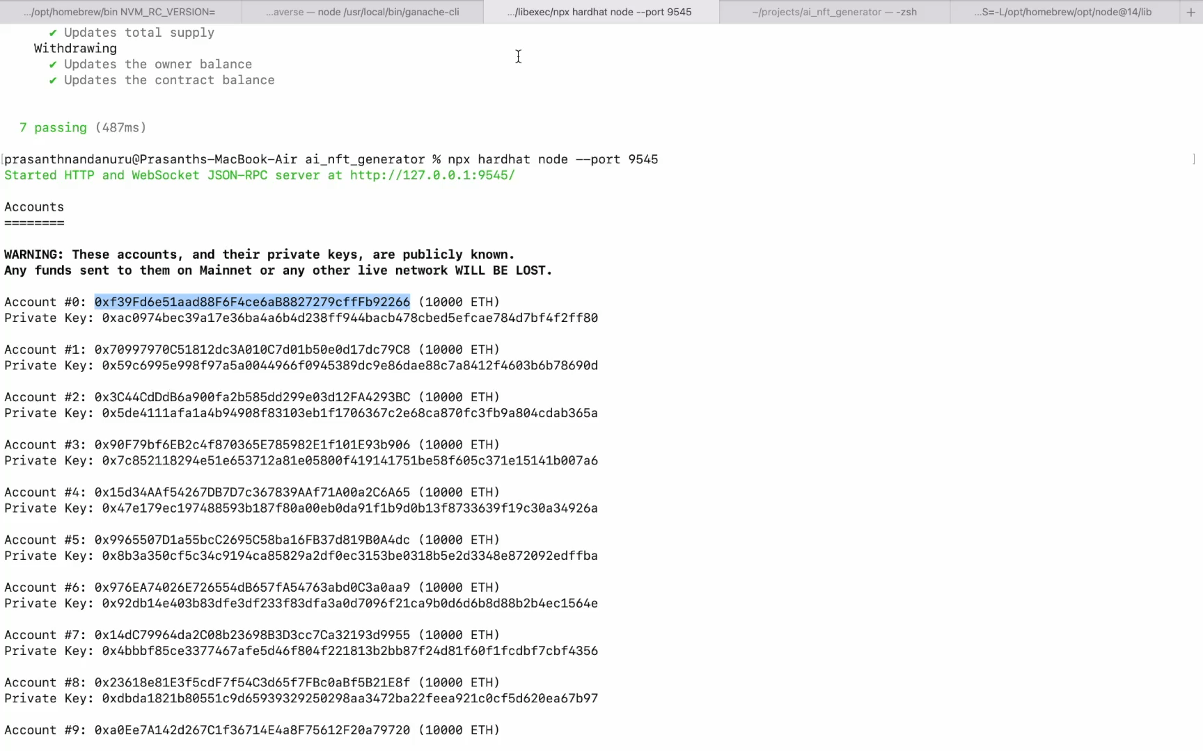
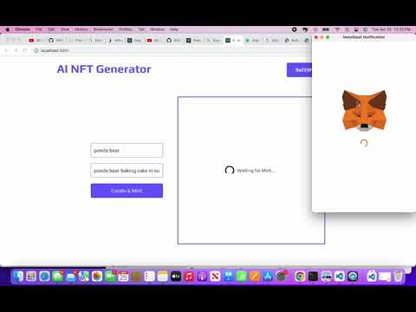
NFT Generator - Stable diffusion model

Slide 36
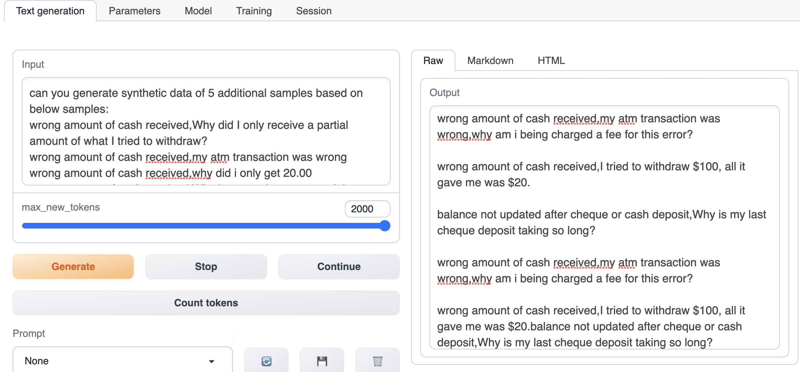
Generative Synthetic Text using LLM and Prompt engineering

Slide 37
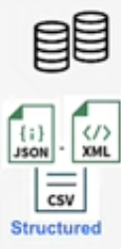

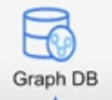

Knowledge Graph and Generative AI
Data Sources
Generative AI
Knowledge Graph
Generative AI
Translate
Ingest
Translate
Natural language
User Interface
Apps

Slide 38
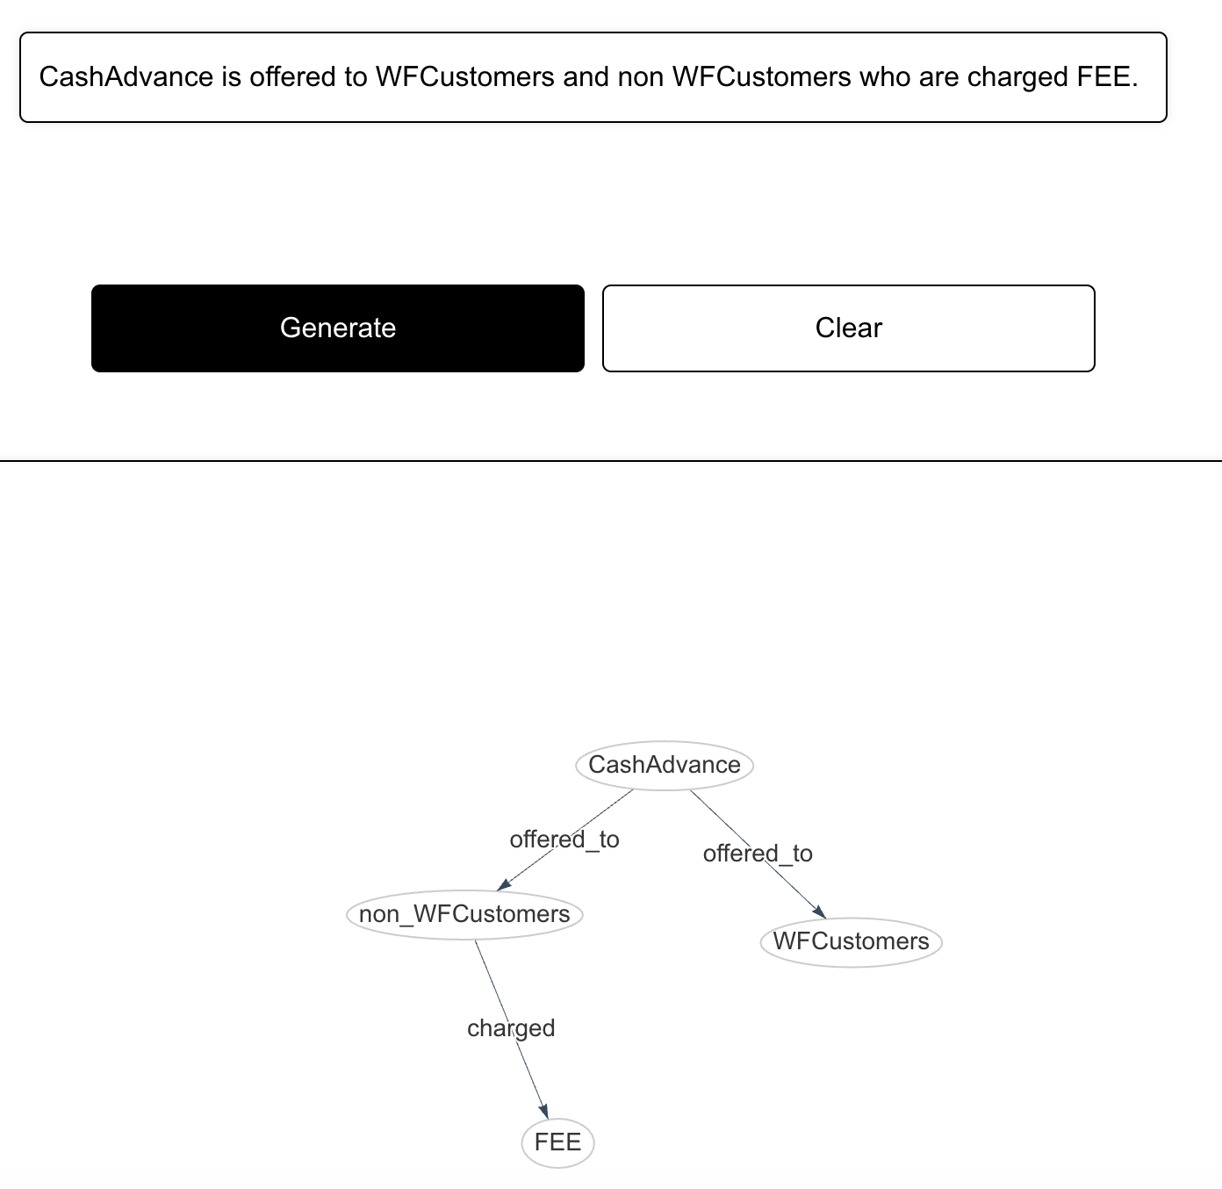
Graph AI
Prompt:
Graph Response:

Slide 39
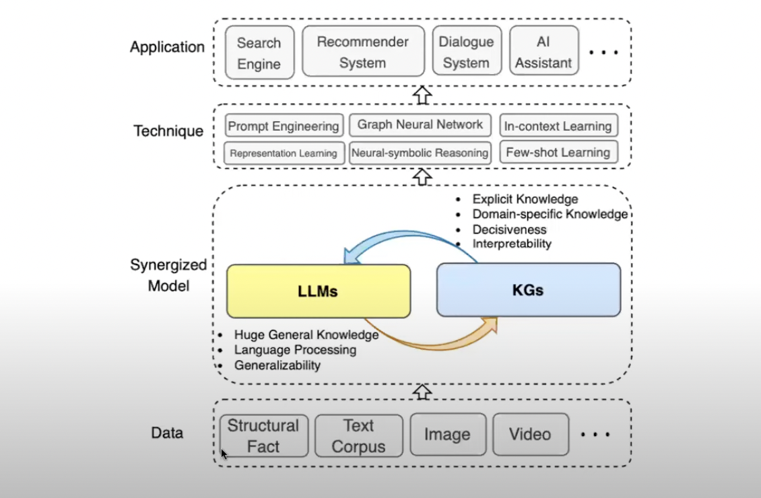
Synergy between LLM and Knowledge Graph

Slide 40

Chosing right LLM Strategy for text generation

Slide 41

AI Guardrails -Langchain or Semantic Kernel Augmentation
Langchain function to integrate with GuadRails Library to meet compliance and regulations
PII/GDPR/CCPA
Nemo guardrails: AI with action on response
await rails.generate_async(prompt =“Tokenise PAN ################“)
async def func (inputs:str)
#Do PAN tokenization logic
panStr=pantokenise(str)
return panStr
rails.register_action(action=func, name=“response”)

Slide 42

Privacy
Techniques
Models
Tools
K-Anonymity
K-Map
l-Diversity
t-CloseNess
Differential Privacy
ARX
Amnesia
Delphix
Anominatron

Slide 43

Security :OWASP Top 10

Slide 44




Deployment approaches
Batch
Real time
Near Real time (Streaming)

Slide 45
Summary
Time Series Problems require domain knowledge
Selection of models is dependent on business goals Training time vs Performance vs Time to Market
Synthetic data generation is not just for Testing . Use for Remix and Simulation of business models
Text and Image Generation using Generative AI solutions are gaining lot of traction and competitive advantage versus Discriminative AI
Privacy , XAI are not good to have but must to account for for any AI solution.

Slide 46
References
https://papers.nips.cc/paper/2019/file/c9efe5f26cd17ba6216bbe2a7d26d490-Paper.pdf
https://github.com/openai/CLIP
https://openai.com/research/clip
https://github.com/microsoft/semantic-kernel
https://docs.langchain.com/docs/use-cases/apis
https://github.com/NVIDIA/NeMo-Guardrails

Slide 47
THANK YOU

